Slide 1
Organization Readiness Self-Assessment

Slide 2
Organizational Readiness Self-Assessment
Introduction
  Change is hard and people and organizations respond to it in different ways. But change is inevitable, especially when transformation requires new ways of engaging with customers, employees and technologies. So how can you help better prepare yourself to achieve your primary goals and business outcomes? Organizational Readiness Self-Assessment
Current State
Transition
Future State
Change Effort
Is the transition from a current state to a future state
The condition at the time the change is initiated
The condition at the time when the benefits have been realized

Slide 3
Organizational Readiness Self-Assessment
Overview
  The Organizational Readiness Self-Assessment tool is a means to assess and evaluate your preparedness and awareness for change across 7 components for successful change
    Vision
    Sponsorship
    Measures
    Change Team
    Communications
    Stakeholders
    Training

Slide 4
Organizational Readiness Self-Assessment
Components
Component | Description
Vision | A common understanding of the primary goals or outcomes the organization is trying to achieve
Sponsorship | Active and visible sponsorship for the change at a senior executive level
Measures | Indicators to track the success of the change initiative based on projected business outcomes
Change Team | Getting people ready to adapt to the changes
Communications | Informing who is affected and impacted regarding the change
Stakeholders | Gaining buy-in for the changes from those involved and affected, directly or indirectly
Training | Teaching the appropriate resources about the change, a particular common practice or change of process and/or behavior

Slide 5
Organizational Readiness Self-Assessment
For each question, enter the number that best represents your organization’s current state
  Select one of the following from the drop-down list in the cell
    1 = Strongly Disagree
    2 = Disagree
    3 = Neutral
    4 = Somewhat Agree
    5 = Agree
    6 = Strongly Agree

Slide 6
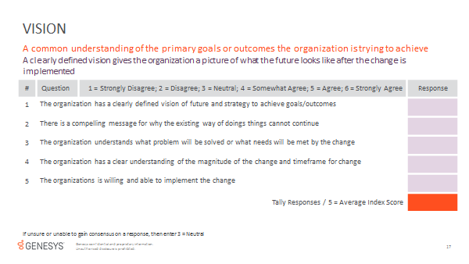
Organizational Readiness Self-Assessment
Arrangement of Questionnaire
Component
Definition
Description
Scale (Response)
Questions
Enter Scores
Calculate Score

Slide 7
Organizational Readiness Self-Assessment
Instructions
  Open Excel File
  Begin with TAB = Directions
    Enter your company’s name
    Enter the date
  Proceed to TAB = Questionnaire
    Each question, select a response from the drop-down list in the cell
    A response is required for all questions
    Once you have completed all 7 components, proceed to TAB = Report

Slide 8
Organizational Readiness Self-Assessment
Tab = Report
  The excel tool will generate a report, based on your inputs, which includes the following:
    Index
    Status
    Explanation
    Evaluation
  Outputs
    Results
    Summary
    Details
    Questionnaire
  If you would like a copy, please select file/print

Slide 9
Organizational Readiness Self-Assessment
Assessment
  Identify Barrier Points and Prioritize
    A score of 4 or less indicates the organization is not fully prepared and should spend efforts to amend
      Overall Readiness
      Component
      Questions
Index | Status | Description | Evaluation | Explanation
1 | Not Ready | Hoping for the best or unaware of the need for preparation | Focus Efforts | The organization is not fully prepared and should spend efforts to amend as soon as possible
2 | Reactionary | React to whatever happens, when it happens | Focus Efforts | The organization is not fully prepared and should spend efforts to amend as soon as possible
3 | Introductory | Early efforts, working through gaps holding us back | Focus Efforts | The organization is not fully prepared and should spend efforts to amend as soon as possible
4 | Basic | Ground work established, building upon foundation | Be Attentive | Although change preparations are adequate, continue to be observant and mindful of change
5 | Situational | Depends on situation, but overall in good shape to handle current conditions | Proceed | The current state of change preparations are favorable
6 | Ready | Well prepared. Able to quickly adapt to change and adjust to changing conditions | Proceed | The current state of change preparations are favorable

Slide 10
Thank You

