Slide 1
VCC Dashboard
Or: How I learned to stop worrying and love PEC!

Slide 2
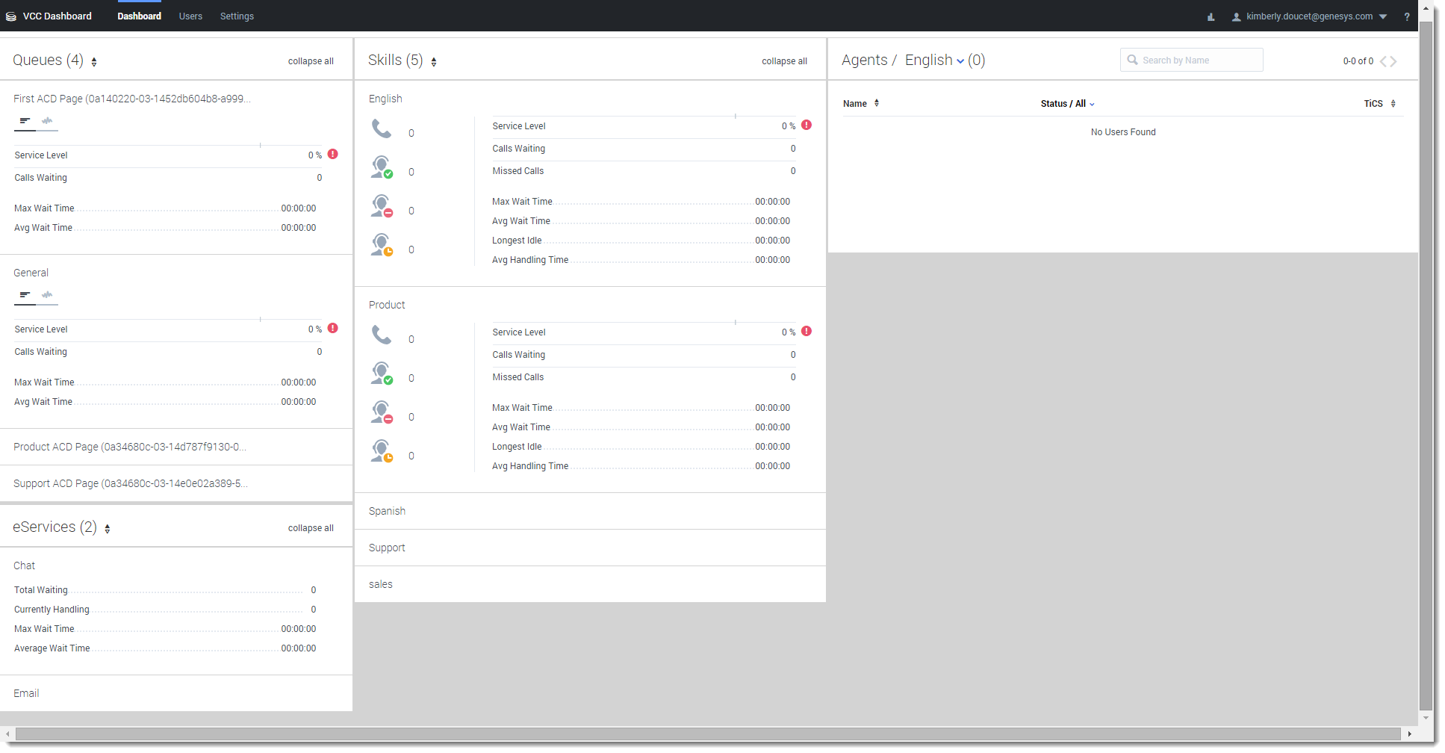
What is VCC Dashboard?
Browser-based app
Supervisors and administrators can see how their teams are performing and if their Service Levels are being met

Slide 3
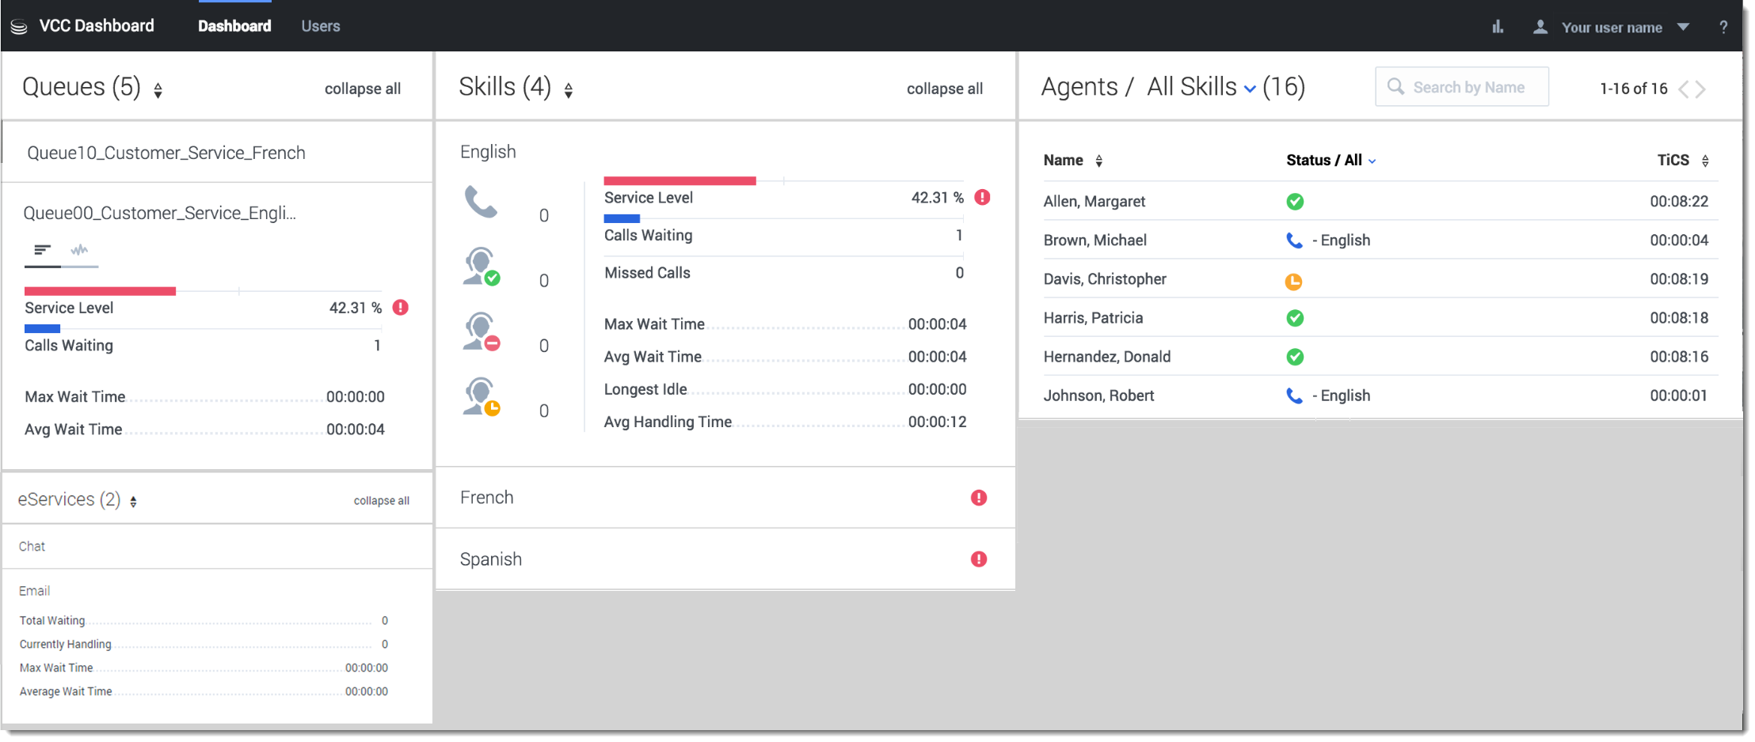
Dashboard View
Helps supervisors and administrators to monitor the real-time status of their queues, skills, and agents.

Slide 4
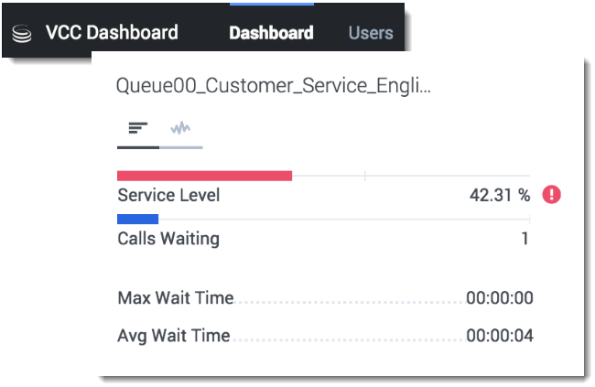
Queues Widgets
Provides supervisors and administrators with statistical information for their queue statistics and their call history answer rate.

Slide 5
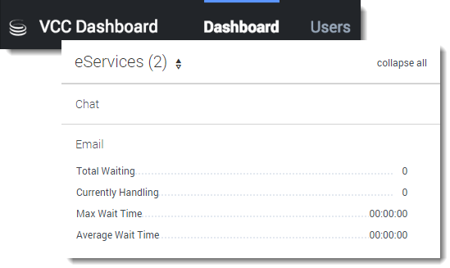
eServices Widgets
Displays the statistical information for your email and chat interactions assigned to your team
Separated into Email and Chat widgets

Slide 6
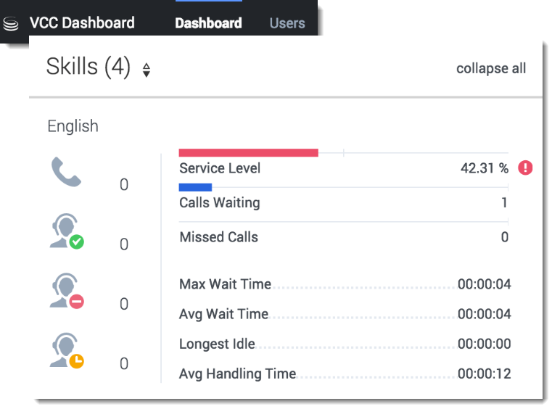
Skills Widgets
Displays the total number of calls waiting for this skill, as well as the number of agents available for that skill.

Slide 7
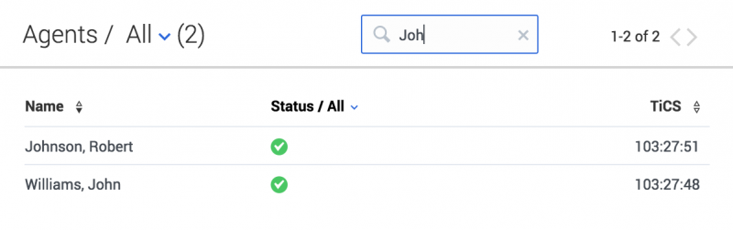
Agents Panel
Displays what status team members are in, how long they've been in this status, and also the reason why they're in this status.

Slide 8
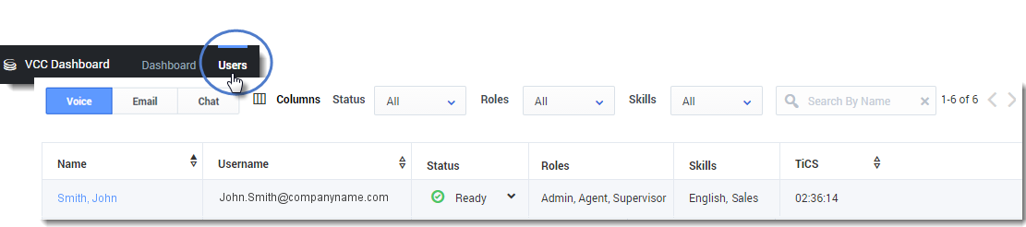
Users View
Helps supervisors and administrators to better understand when agents need assistance and why agents are not available to handle calls.

Slide 9
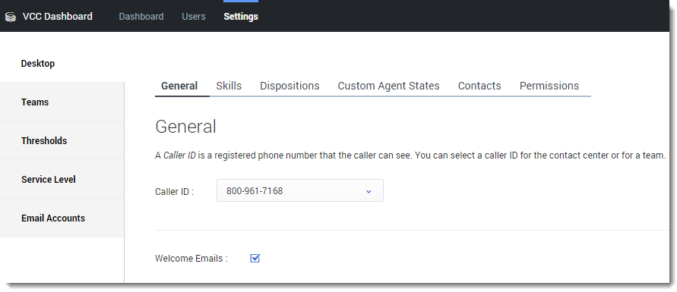
Settings View
Administrators can set system configurations on an on-demand basis and customize their contact center.

Slide 10
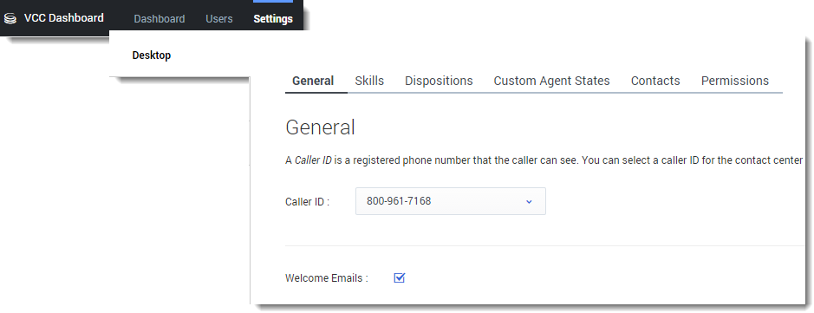
Desktop View
Administrators can configure what agents see on their desktops (VCC Agent Desktop).

Slide 11
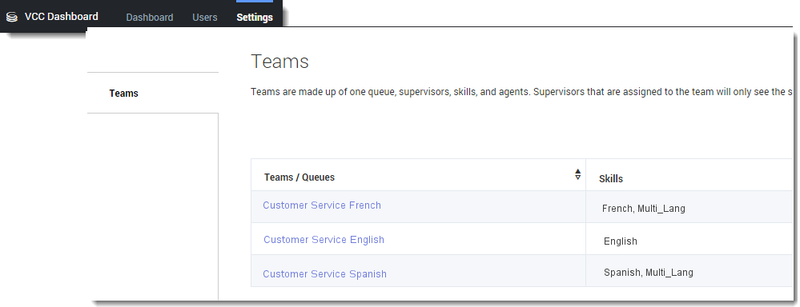
Teams View
Administrators can use the Teams view to manage the teams (ACD queues).

Slide 12
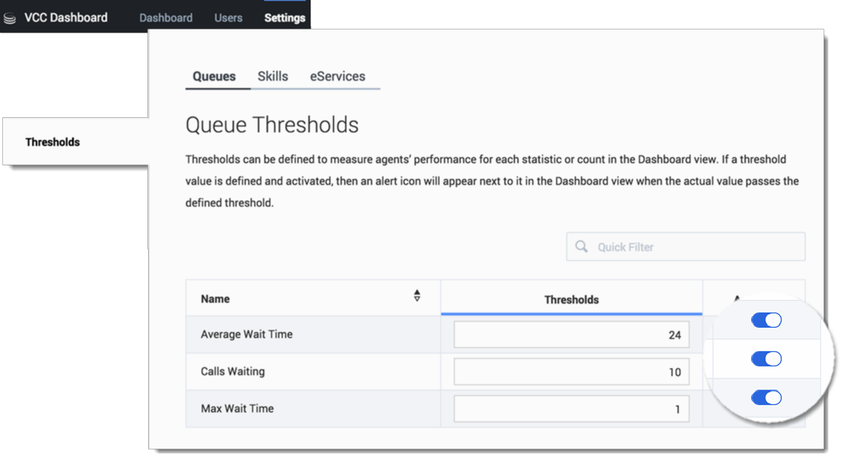
Thresholds View
Administrators can set thresholds for the statistics that are displayed in the Dashboard's Queues, Skills, and eServices widgets.

Slide 13
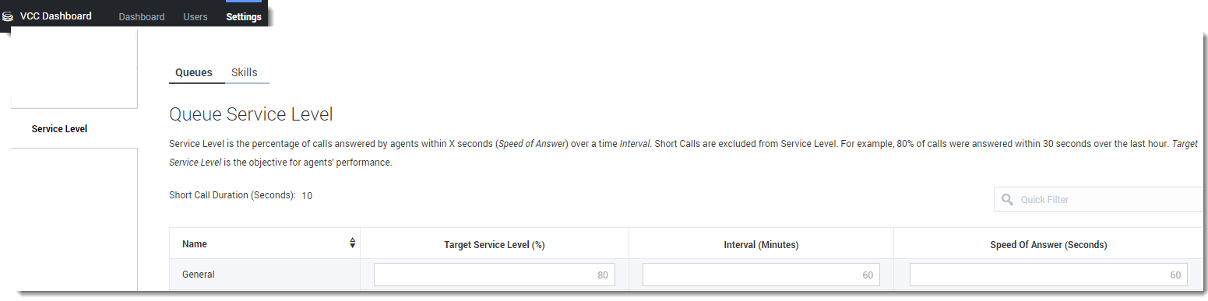
Service Level View
Administrators can use the Service Level view to configure the Queue and Skills Service Level settings for each queue or skill.

Slide 14
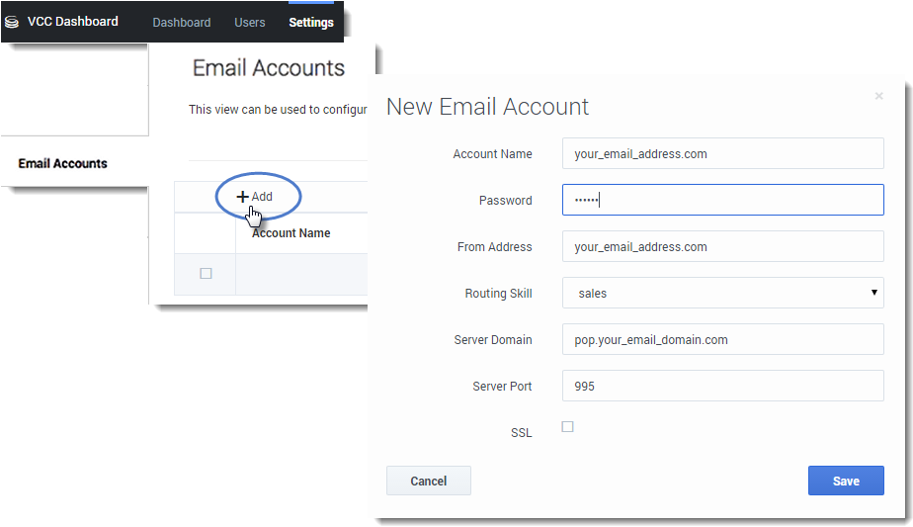
Email Accounts View
Used to configure multiple email accounts for routing email interactions to agents.

