Slide 1
VCC 2.5.9
Outbound Feature Highlights

Slide 2
Agenda
  Configuring Email Settings
  Label Change in Queue and Skill Service Levels
  Real-time Reporting for Chats
  Real-time Reporting for Emails
  Enabling Disposition Codes for Outbound Calls
  Enabling Nailed Up Connections
  Creating New Users Using VCC Dashboard
  Outbound Campaign Call Recording
  Outbound Campaign Compliance Management
  WebRTC Improvements
  VCC CX Analytic Updates
Notes:
This is the breakdown of the new VCC important features.

Slide 3
Outbound Overview
Outbound is an automated system that is used to create, modify, and run outbound dialing
campaigns/dialing sessions (for example, collections,
telemarketing, or fundraising) in which the contact interactions are outbound voice calls
that are based on calling a predetermined list of contacts.
VCC supports the following dialing types:
Predictive calls — These are outbound campaigns in which the system dials calls predicting
that agents will be available when the call is answered. These campaigns normally expect that
some calls will not be answered due to no agents being available. These are for low value/high
volume campaigns.
Progressive calls — The system will only dial a call when an agent is available, to ensure that
when the call is answered, an agent is available to answer the call. These campaigns are for
higher value customers.
Campaigns, sub-campaigns, and calling lists can be created by using the new Engage UI.
Notes:
Outbound is an automated system that is used to create, modify, and run outbound dialing campaigns/dialing sessions (for example, collections,
telemarketing, or fundraising) in which the contact interactions are outbound voice calls that are based on calling a predetermined list of contacts.

Slide 4
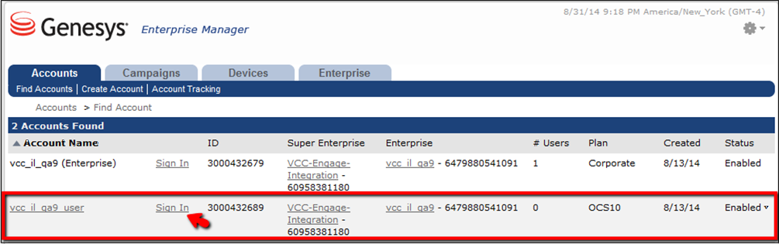
Accessing Enterprise Manager
In Enterprise Manager, located in the Engage UI, there are enterprises containing the
following top-level accounts in which campaigns are run:
Enterprise Account
User Account (you only need to configure the User Account.)
To access Enterprise Manager, you log into the Engage UI using the supplied URL then enter
your User ID and initial password.
Notes:
In Enterprise Manager, located in the Engage UI, there are enterprises containing the following top-level accounts in which campaigns are run:
Enterprise Account
User Account (you only need to configure the User Account.)
To access Enterprise Manager, you log into the Engage UI using the supplied URL then enter your User ID and initial password.

Slide 5
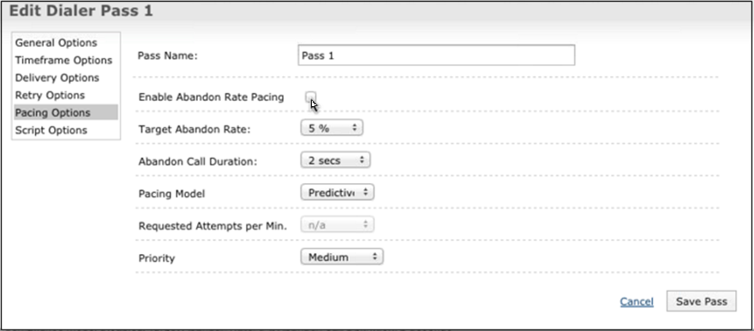
Predictive Pacing Percentages
You can set a predictive pacing percentage for predictive campaigns in the Engage UI.
Notes:
You can set a predictive pacing percentage for predictive campaigns in the Engage UI.

Slide 6
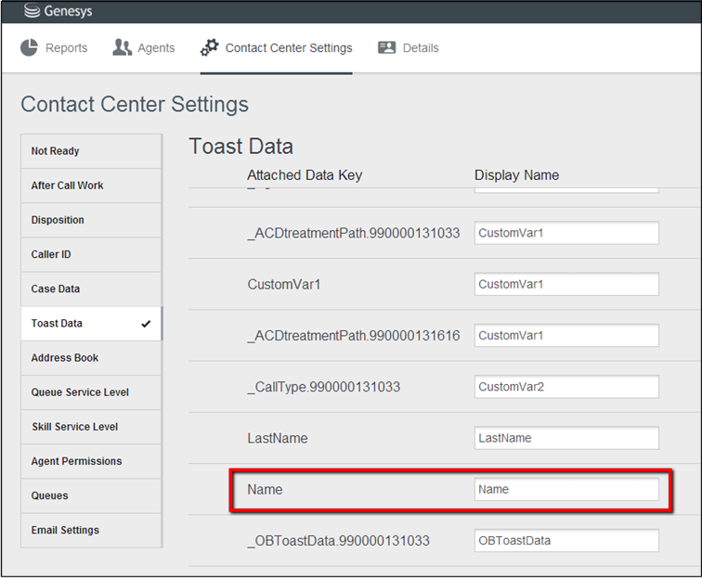
Provisioning Toast and Case Data for Outbound Campaigns
For outbound campaigns, Toast and Case data are provisioned by using the Toast Data
and Case Data tabs in the Contact Center Settings view in VCC Dashboard.
Note that this provisioning is different from inbound calls in which this data is provisioned by
using the ACD Page within CX Builder.
Notes:
For outbound campaigns, Toast and Case data are provisioned by using the Toast Data and Case Data tabs in the Contact Center Settings view in VCC Dashboard.
Note that this provisioning is different from inbound calls in which this data is provisioned by using the ACD Page within CX Builder.

Slide 7
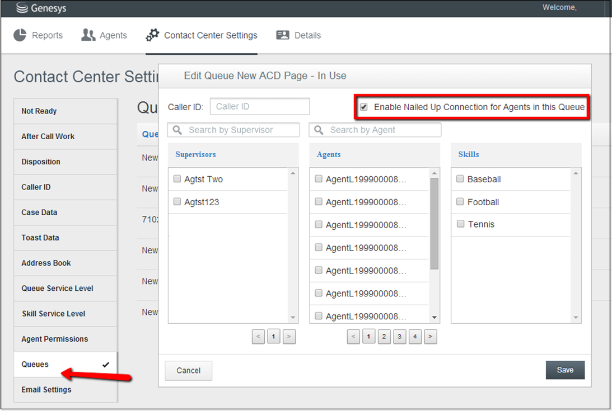
Nailed Up Connections
You can now enable or disable a nailed up connection for agents assigned to a specific queue. A nailed up connection is a persistent connection in which the agent phone remains connected to the media server so that when a call is received, the call must only be bridged to this persistent connection, enabling a quicker answer-time.
This setting is configured under Contact Center Settings > Queues. Click the Enable Nailed Up Connection for Agents in Queue checkbox in the Edit Queue dialog box to enable this connection.
Notes:
You can now enable or disable a nailed up connection for agents assigned to a specific queue. A nailed up connection is a persistent connection in which the agent phone remains connected to the media server so that when a call is received, the call must only be bridged to this persistent connection, enabling a quicker answer-time.
This setting is configured under Contact Center Settings > Queues. Click the Enable Nailed Up Connection for Agents in Queue checkbox in the Edit Queue dialog box to enable this connection.

Slide 8
Outbound Campaign Call Recording
  You can record Outbound Campaign calls by using the Record feature on the interaction toolbar.
Notes:
Agents can record Outbound Campaign calls by using the Record feature on the interaction toolbar.

Slide 9
Outbound Campaign Compliance Management
  The Outbound Campaign Calls features meet the required national and international calling laws.
Notes:
The Outbound Campaign Calls features meet the required national and international calling laws.

Slide 10
WebRTC Improvements
  Agents can now register Endpoints with the system and receive calls through the Endpoint (VoiP), instead of using a PSTN phone.
  Note: The Endpoint is a WebRTC-enabled browser.
Notes:
Agents can now register Endpoints with the system and receive calls through the Endpoint instead of using a PSTN phone. Note: The Endpoint is a WebRTC enabled browser.

Slide 11
Thank You

