Slide 1
VCC 2.5.9
Email Feature Highlights

Slide 2
Agenda
  VCC Email Channel Overview
  VCC Dashboard Email Widget
  VCC Dashboard Email Settings View
  VCC Agent Desktop Email Features Overview
    Managing the Channel Status
    Agent Status Monitoring for all Channels
    Channel Selection
    Toast Data for Email
    Inbound Email Interaction Window
    Inbound and Outbound Workbins
    Contact History View
    Contact History Notes, Details, and Case Data
    Email Control – Voice Consultation and Email Transfers
    Outbound Email Interactions Window
    Email Contact and Directory and Outbound Email
  CX Analytics Email Features Overview
    Queue Activity - Time: Email Report
    Queue Statistics - Day: Email Report
    Agent Activity – Day Report
    Agent Statistics - Day: Email Report

Slide 3
VCC Email Channel Overview
VCC now supports email interactions from your customers. The Genesys Email Server connects to your corporate email server and pulls email messages from the account that is configured in your system. Agents use VCC Agent Desktop to handle email interactions.

Slide 4
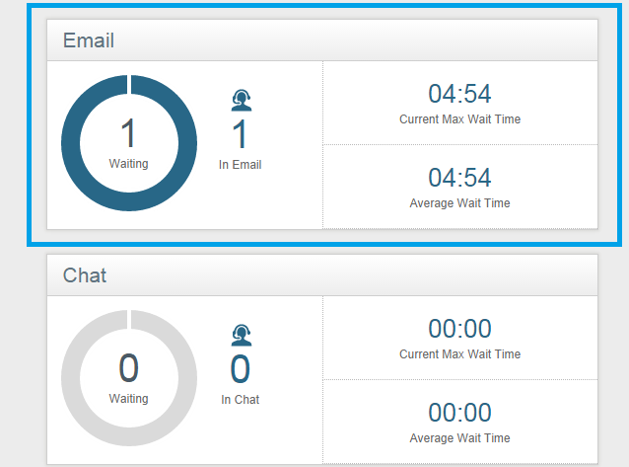
VCC Dashboard Email Widget
  Real-time reporting for email interactions using the Email widget is available in the Reports view.
  The Email widget displays the following reporting statistics at the contact center level:
  the number of email interactions waiting
  the current maximum wait-time for email interactions
  the average wait-time for email interactions
  Email routing controls which agents receive email interactions based on the email skill request.
Notes:
Overview of the new Email widget in VCC Dashboard’s Report view.

Slide 5
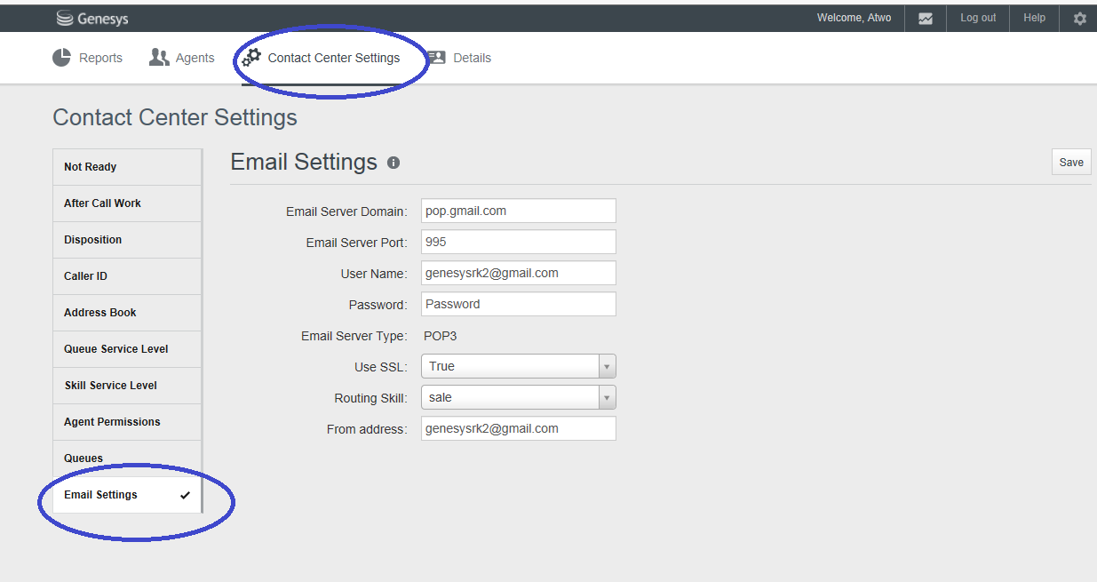
VCC Dashboard Email Settings View
As an administrator, you can now configure a connection to the customer email server. This
connection supports a single inbound email address and is associated with one skill for email
routing. You can enable this feature using the Email Settings tab located under the Contact
Center Settings view.
Notes:
Configuring the Email Settings view in VCC Dashboard.

Slide 6
VCC Agent Desktop Email Features Overview
Depending on the types of media channels assigned, an agent can handle one or more interactions using the different channel types (Voice, Chat, or Email).
The concurrent interaction setting for the Email channel is one interaction per agent. The agent is always available for other channels. When handling email interactions, the agent:
  Can take one chat interaction or one voice interaction while handling an email interaction
  Is notified of incoming email interactions
  Can control their individual channel (Voice, Chat, Email) status
  Can accept or reject incoming email interaction
  Can make a consultation call on the Voice channel during email interactions
  Can transfer email interactions to other agents
Notes:
VCC Agent Desktop Email Features Overview

Slide 7
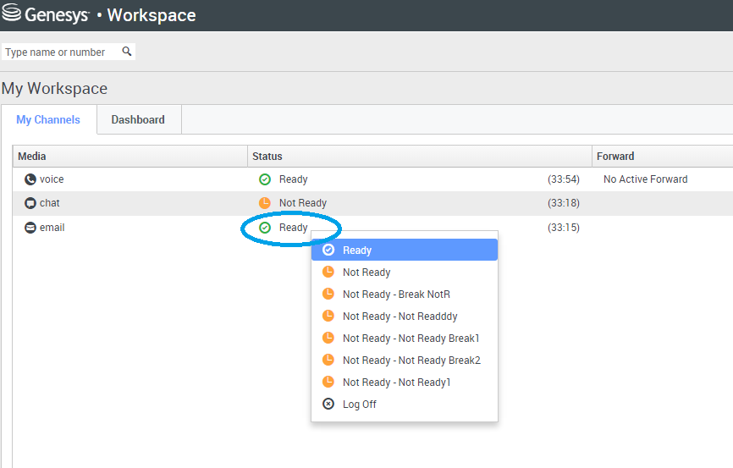
Managing Channel Status
The Voice channel is automatically set to the default Ready status when an agent
logs in to the system. Agents can then set their status to:
Ready to accept email interactions
Not Ready to accept email interactions
Notes:
The Voice channel is automatically set to the default Ready status when an agent logs in to the system. Agents can then set their status to:
Ready to accept email interactions
Not Ready to accept email interactions

Slide 8
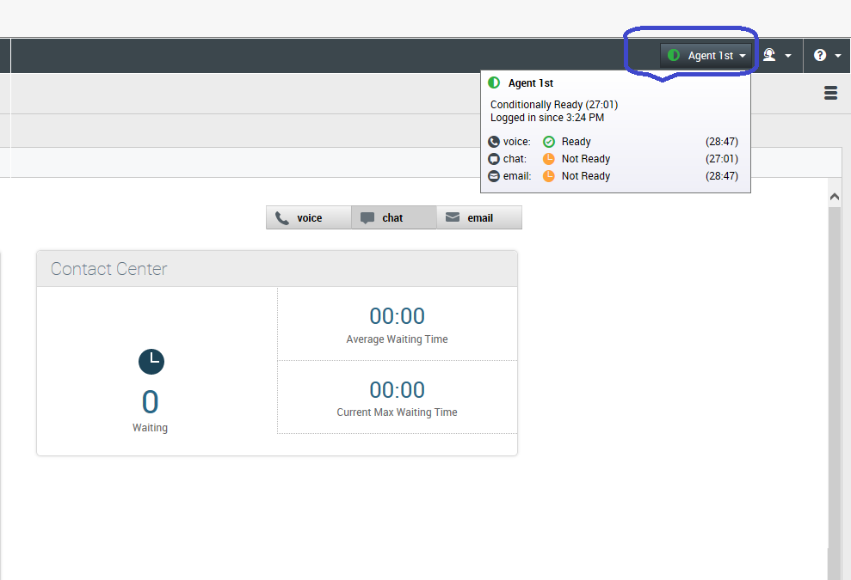
Agent Status Monitoring for all Channels
Agents can view their status summary (login name, channels, and channel status) by placing
their mouse pointer over the Agent Status icon.
Notes:
Agents can view their status summary (login name, channels, and channel status) by placing
their mouse pointer over the Agent Status icon.

Slide 9
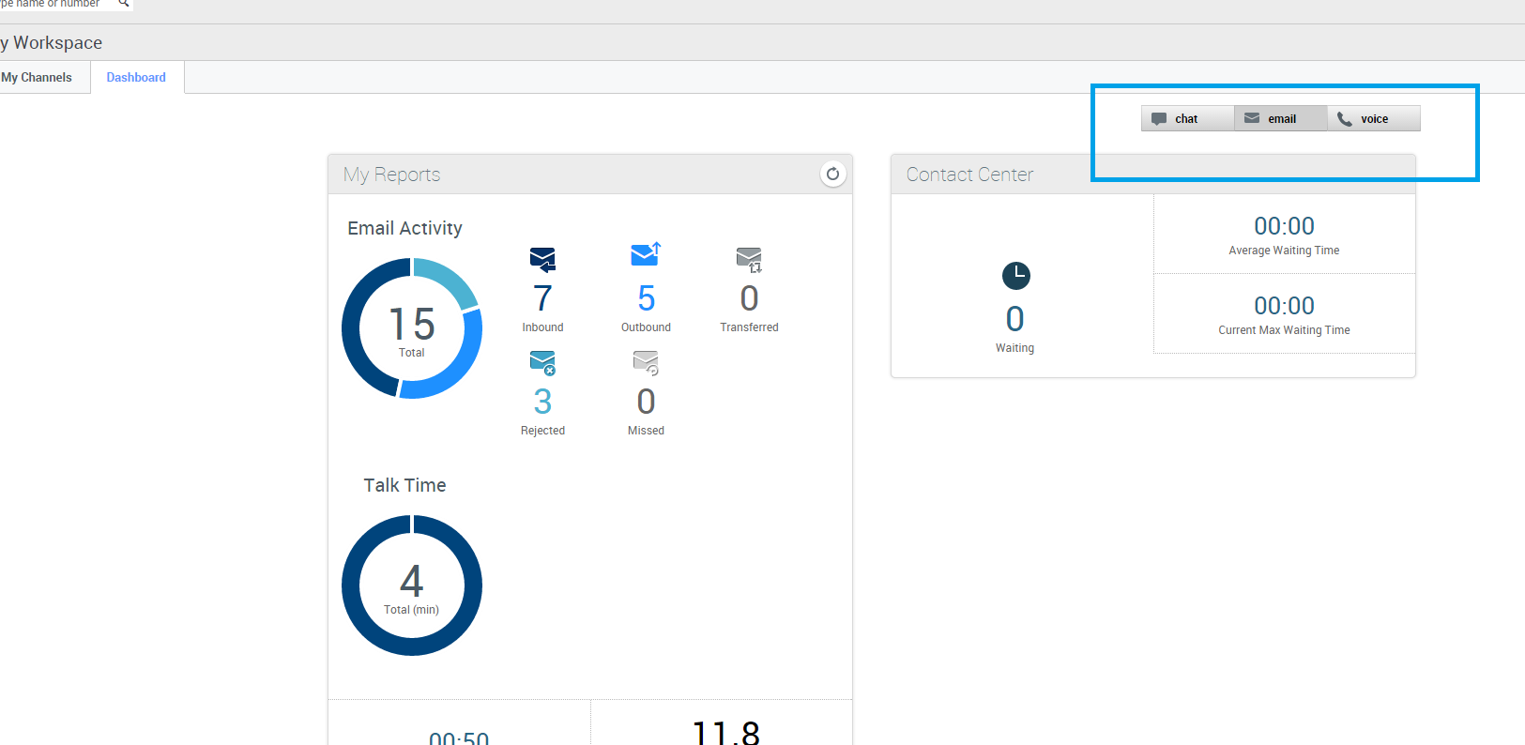
Channel Selection
Agents can select which interaction channel they are using to see their key performance indicators
(KPIs).
Notes:
Agents can select which interaction channel they are using to see their key performance indicators (KPIs).

Slide 10
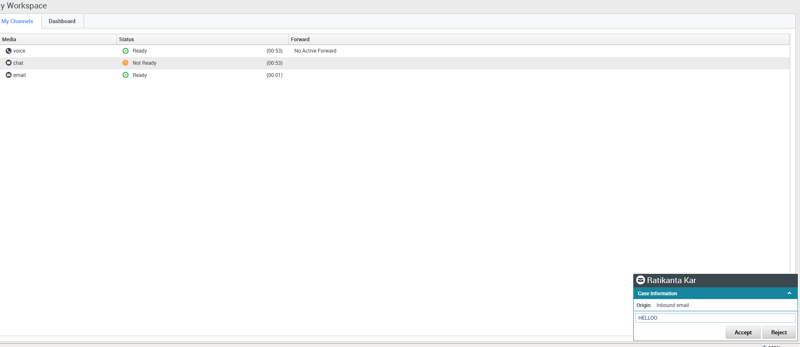
Toast Data for Email
Toast data displays an interactive notification that enables agents to preview a new inbound
email interaction. This notification includes attached data that enables agents to decide
whether to accept or decline the interaction.
Agent Toast Data
Notes:
Toast data displays an interactive notification that enables agents to preview a new inbound
email interaction. This notification includes attached data that enables agents to decide
whether to accept or decline the interaction.

Slide 11
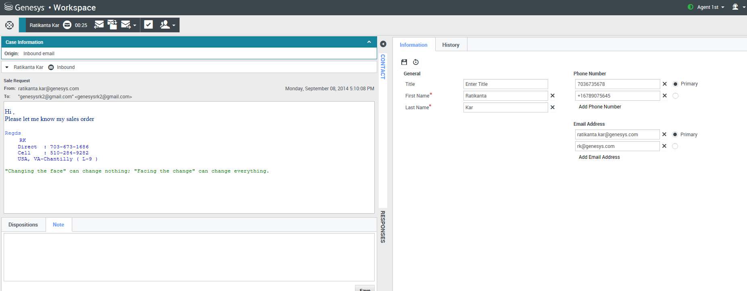
Inbound Email Interaction Window
The Inbound Email Interaction window enables you to handle many e-mail related
tasks.
Notes:
The Email Interaction window enables you to handle many e-mail related tasks.

Slide 12
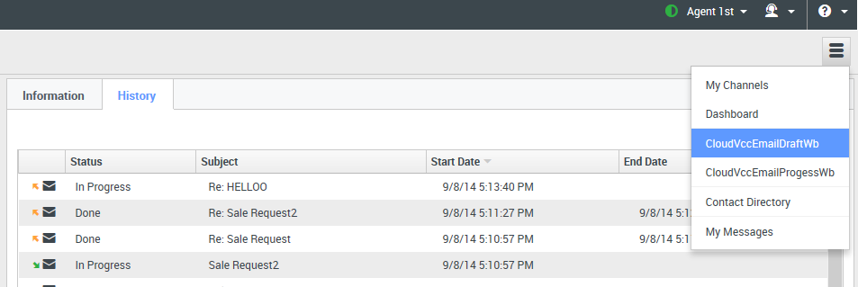
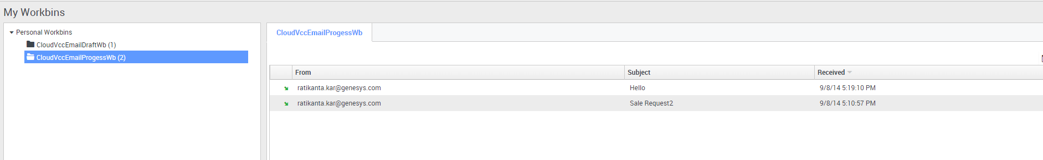
Inbound and Outbound Workbins
A workbin is similar to a personal queue where you can store e-mail and other interactions to be
handled later.
Notes:
A workbin is similar to a personal queue where you can store e-mail and other interactions to be handled later.

Slide 13
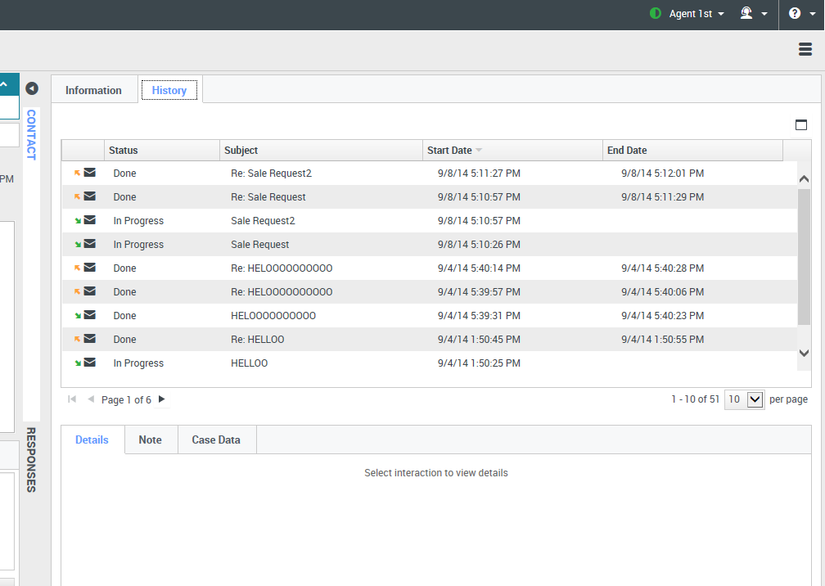
Contact History View
The History tab displays the contact history, which details the interactions that agents
selected in the Contact History view of the person contacting the contact center.
Notes:
The History tab displays the contact history, which details the interactions that agents selected in the Contact History view of the person contacting the contact center.

Slide 14
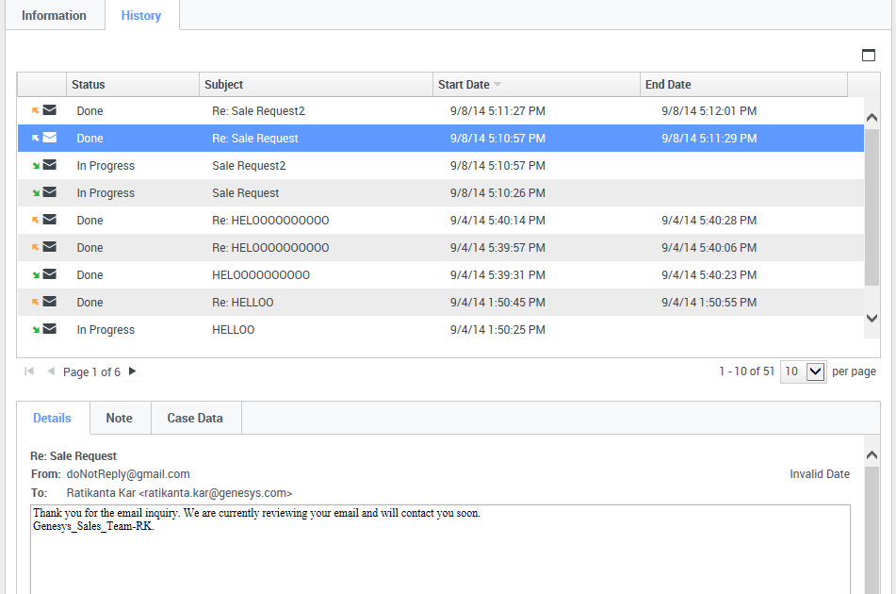
Contact History Notes, Details, Case Data
Agents can use Details to view information such as time stamp and email subject
Agents can use Note to attach a note to the interaction history
Agents can use Case Data to view the case information for the interaction history
Notes:
Agents can use Details to view information such as time stamp and email subject.
Agents can use Note to attach a note to the interaction history.
Agents can use Case Data to view the case information for the interaction history.

Slide 15
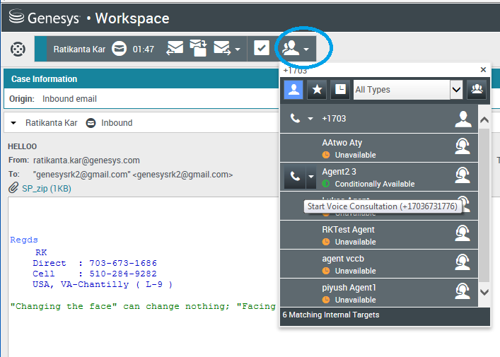
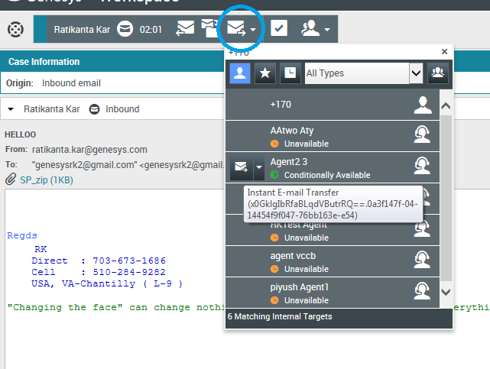
Email Control –
Voice Consultation and Email Transfers
Agents can start a voice consultation with another agent about their email session
Agents can transfer their email interaction to their consultation target
Notes:
Agents can start a voice consultation with another agent about their email session
Agents can transfer their email interaction to their consultation target

Slide 16
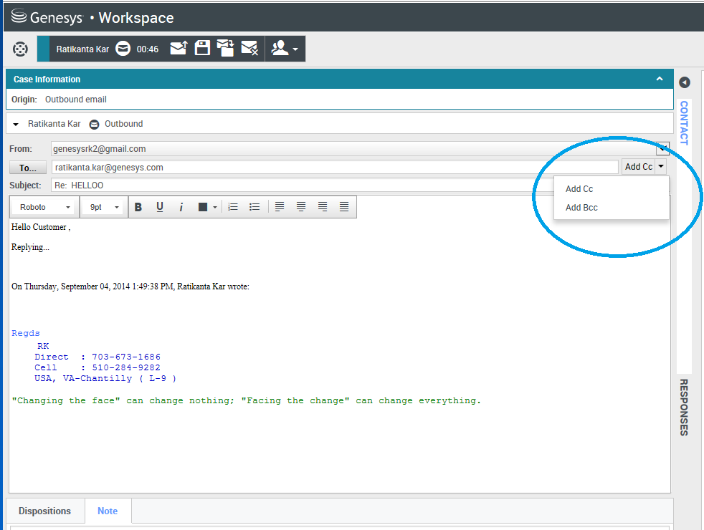
Outbound Email Interactions Window
The Outbound E-mail Interaction window enables you to handle many e-mail-related
tasks, including the following:
Add one or more Carbon Copy (CC) recipients
Add one or more Blind Carbon Copy (BCC) recipients
Notes:
The Outbound E-mail Interaction window enables you to handle many e-mail-related
tasks, including the following:
Add one or more Carbon Copy (CC) recipients
Add one or more Blind Carbon Copy (BCC) recipients

Slide 17
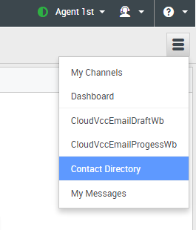
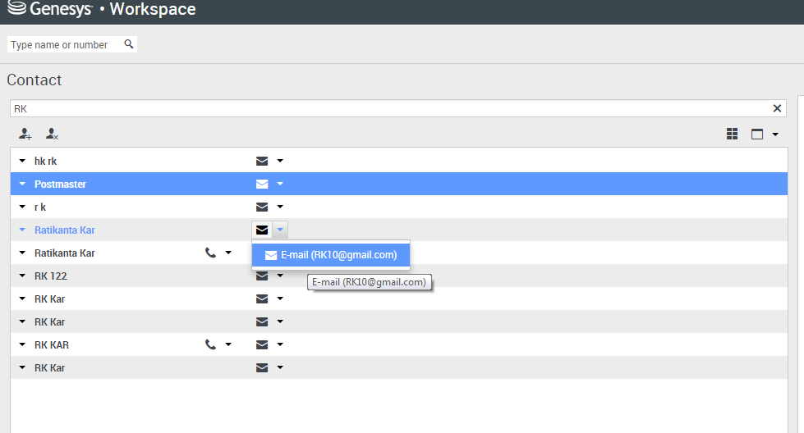
Email Contact Directory and Outbound Email
The Contact Directory enables you to do the following:
Find contacts
Manage contacts by using contact actions
Notes:
The Contact Directory enables you to do the following:
Find contacts
Manage contacts by using contact actions

Slide 18
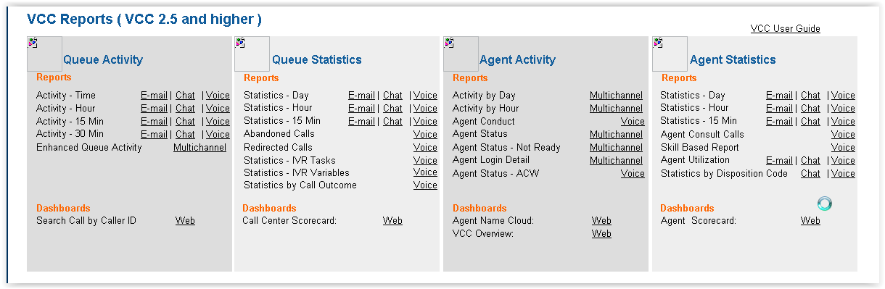
CX Analytics Email Features Overview
New Channel (Chat, Email, and Multichannel) reports for increased reporting capabilities.
Multichannel reports include statistics for all channels to which the agent is assigned.
New Channel Reports - Chat, Email, and Multichannel
Notes:
New Channel (Chat, Email, and Multichannel) reports for increased reporting capabilities.
Multichannel reports include statistics for all channels to which the agent is assigned.

Slide 19
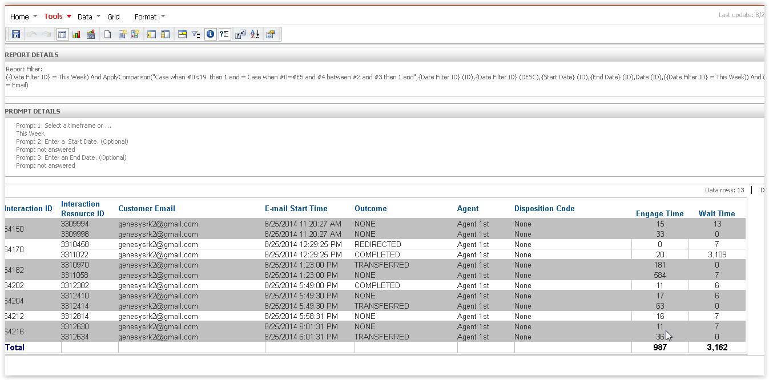
Queue Activity - Time: Email Report
Notes:
Queue Activity - Time: Email Report

Slide 20
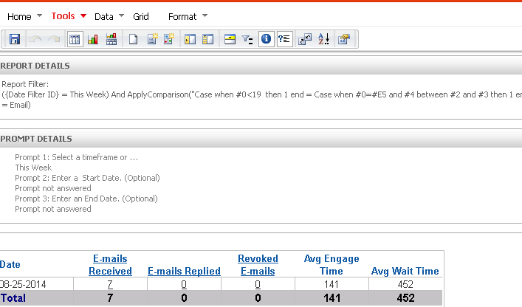
Queue Statistics - Day: Email Report
Notes:
Queue Statistics - Day: Email Report

Slide 21
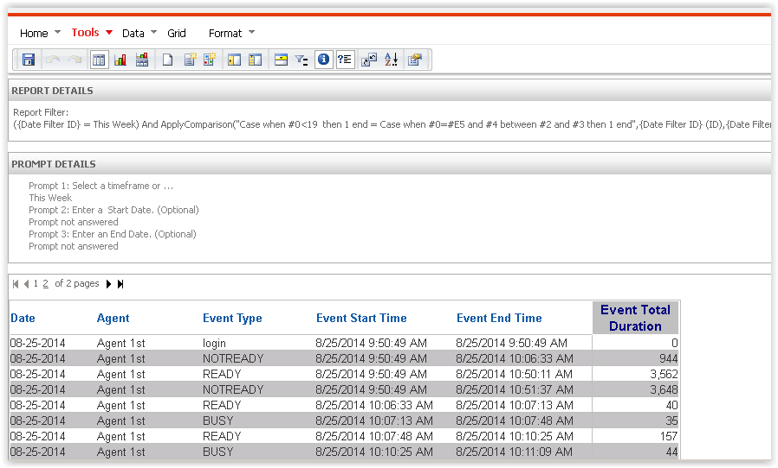
Agent Activity – Day Report
Notes:
Agent Activity – Day Report

Slide 22
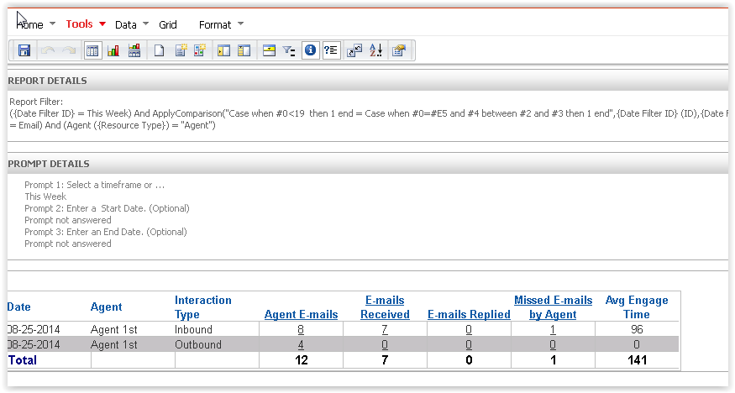
Agent Statistics - Day: Email Report
Notes:
Agent Statistics - Day: Email Report

Slide 23
Thank You!

