Slide 1
VCC 2.5.9
Chat Feature Highlights

Slide 2
Agenda
  VCC Chat Channel Overview
  VCC Dashboard Chat Features Overview
  VCC Agent Desktop Chat Features Overview
    Managing the Channel Status
    Agent Status Monitoring for all Channels
    Channel Selection
    Toast Data for Chat
    Chat Interaction View
    Agent Chat Preview and Status
    Contact History View
    Contact History Notes, Details, and Case Data
    Chat Control – Voice Consultation and Chat Transfers
    Chat Transfer History, Note, and Dispositions
  CX Analytics Chat Features Overview
    Queue Activity - Time: Chat Report
    Queue Statistics - Day: Chat Report
    Agent Activity – Day Report
    Agent Statistics - Day: Chat Report
  Customer Website Chat Widget
  Premier Edition: VCC Chat Widget
Notes:
This is the breakdown of the new VCC important Chat features.

Slide 3
VCC Chat Channel Overview
VCC now supports chat interactions from your customers. Genesys Chat Server connects to your corporate website and the provided client widget sends and receives chats between your agents and your customer contacts. Chat interactions are handled similar to voice calls by using the same VCC Agent Desktop with which your agents are familiar.
VCC chat functionality allows website visitors to chat with VCC agents, which:
  Improves customer service (agents can handle three times more chat interactions than voice interactions)
  Enables live interaction and updates for instant customer satisfaction
Notes:
Overview of the new VCC Chat channel functionality.

Slide 4
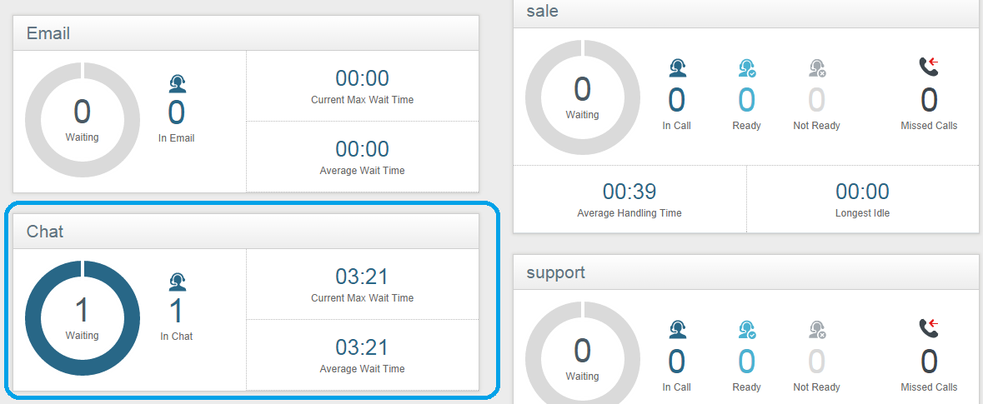
VCC Dashboard Chat Features Overview
  Real-time reporting for chat interactions using the Chat widget is available in the Reports view.
  The Chat widget displays the following reporting statistics at the contact center level:
  The number of chat interactions waiting
  The current maximum wait-time for chat interactions
  The average wait-time for chat interactions
  The number of agents currently handling chats
  Chat routing controls which agents receive chat interactions based on the chat skill request.
Notes:
Overview of the new Chat widget in VCC Dashboard’s Report view.

Slide 5
VCC Agent Desktop Chat Features Overview
Depending on the types of media channels assigned, an agent can handle one or more interactions using the different channel types (Voice, Chat, or Email).
The concurrent interaction setting for the Chat channel is three chat interactions per agent (if an agent is not handling any chat interactions then the agent is available for voice interactions). When handling chat interactions, the agent:
  Is notified when a client is typing a message (the client is notified, as well)
  Can control their individual channel (Voice, Chat, Email) status
  Can accept or reject incoming chat interactions
  Can make a consultation call on the Voice channel during chats
  Can transfer chat interactions to other agents
Notes:
VCC Agent Desktop Chat Features Overview

Slide 6
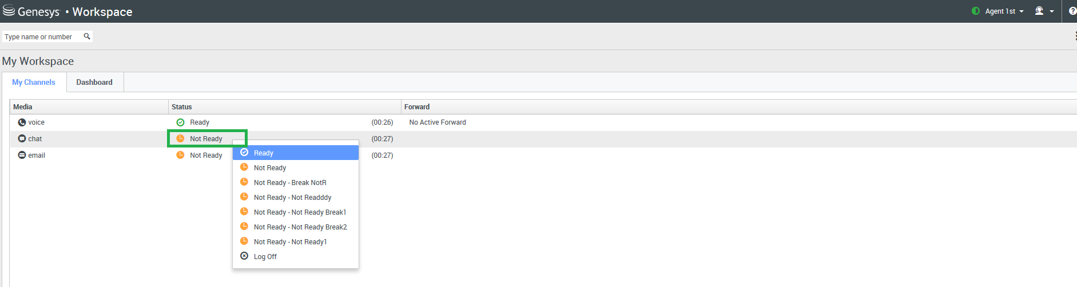
Managing Channel Status
The Voice channel is automatically set to the default Ready status when an agent
logs in to the system. Agents can then set their status to:
Ready to accept chat interactions
Not Ready to accept voice interactions
Notes:
The Voice channel is automatically set to the default Ready status when an agent logs in to the system. Agents can then set their status to:
Ready to accept chat interactions
Not Ready to accept voice interactions

Slide 7
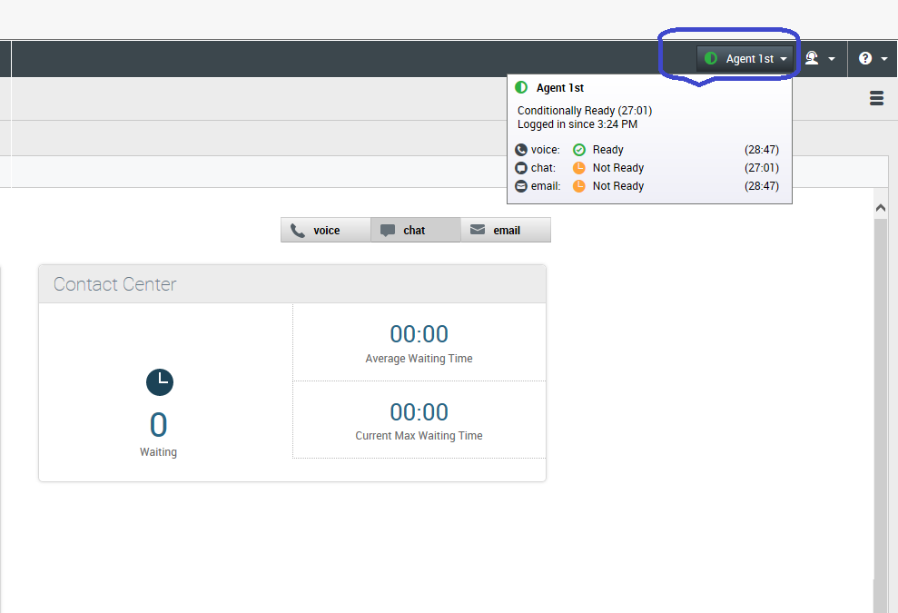
Agent Status Monitoring for all Channels
Agents can view their status summary (login name, channels, and channel status) by placing their mouse pointer over the Agent Status icon.
Notes:
Agents can use the Agent Status icon to view their status summary.

Slide 8
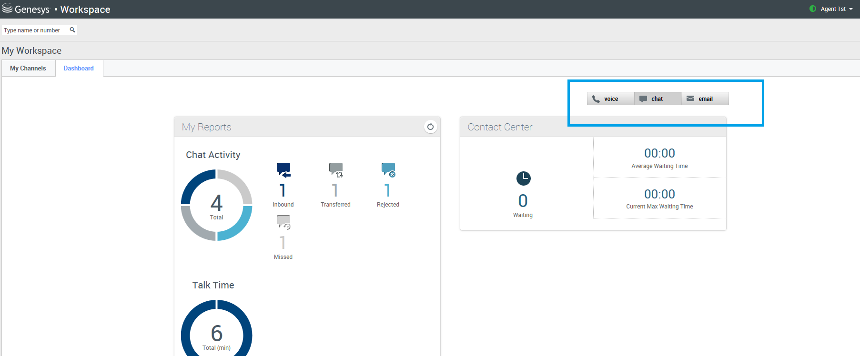
Channel Selection
Agents can select which interaction channel they are using to see their key performance indicators (KPIs).
Notes:
Agents can select which interaction channel they are using to see their key performance indicators (KPIs).

Slide 9
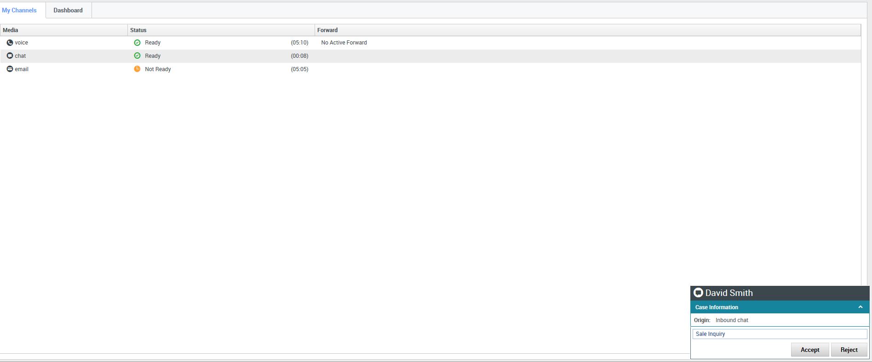
Toast Data for Chat
Toast data displays an interactive notification that enables agents to preview a new
inbound chat interaction. This notification includes attached data that enables agents to decide
whether to accept or decline the interaction.
Toast data for an inbound chat interaction
Notes:
Toast data includes attached data that enables agents to decide whether to accept or decline the interaction.

Slide 10
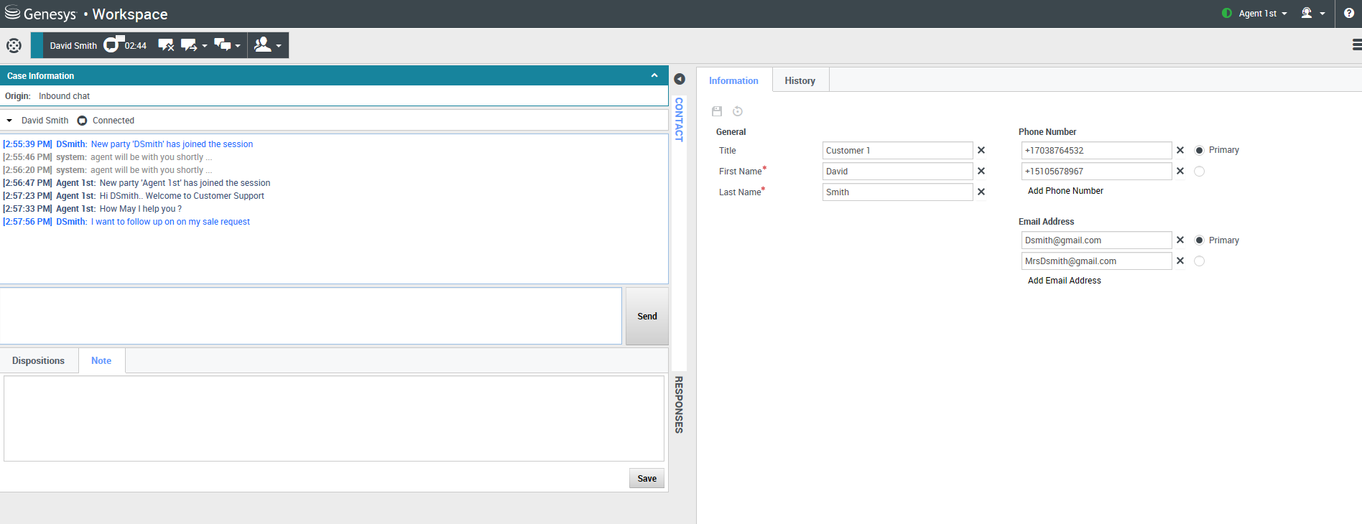
Chat Interaction View
When an agent accepts a chat interaction, the Chat Interaction view is displayed
on the left-hand side of the screen.
Notes:
When an agent accepts a chat interaction, the Chat Interaction view is displayed in the left-hand side of the screen. This view is comprised of different sections, such as the Chat Transcript area where agents can view the contents of chat messages, such as the names of the chat participants, the time of each event and message. It also displays the Chat Message area where agents enter and preview their messages before they send them to their contacts.

Slide 11
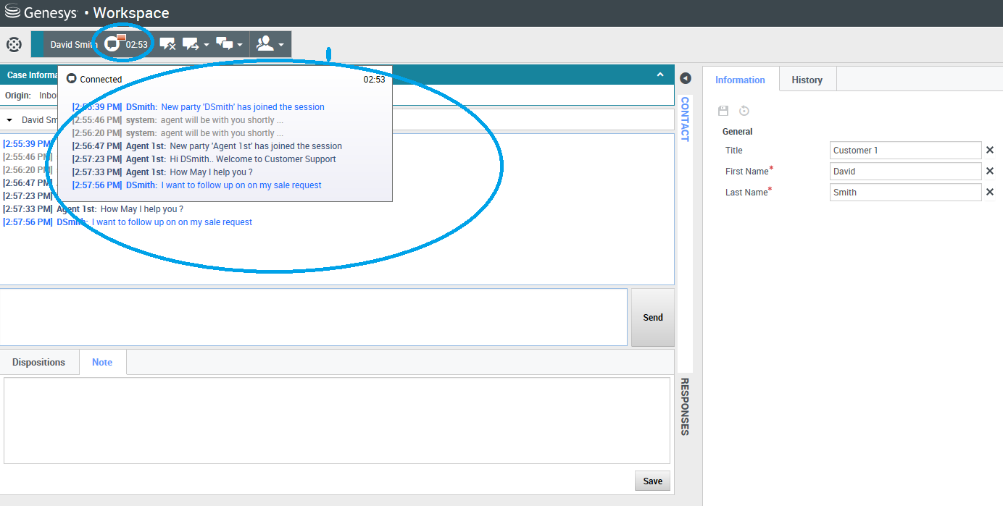
Active Chat Preview and Status
The pending response indicator shows that an agent has a pending-response to their contact.
Notes:
When agents receive a message from their contact, a timer is started. The duration of the timer is specified by their contact center administrator. The timer indicates that they have a pending-response to their contact. The pending-response indicator is displayed next to the interaction-type icon at the top of the interaction view.
The color of the pending response indicator changes depending on the time it takes an agent to respond to the interaction. It changes from green, to yellow, to red and begins to flash.
If agents have a pending response, and the Chat interaction view is not the active view, it begins to flash in the Windows taskbar, regardless of the condition that is displayed by the pending-response indicator.
If you place your mouse pointer over any flashing item, a preview of the interaction is displayed and the flashing stops. The preview displays the latest message from the contact.

Slide 12
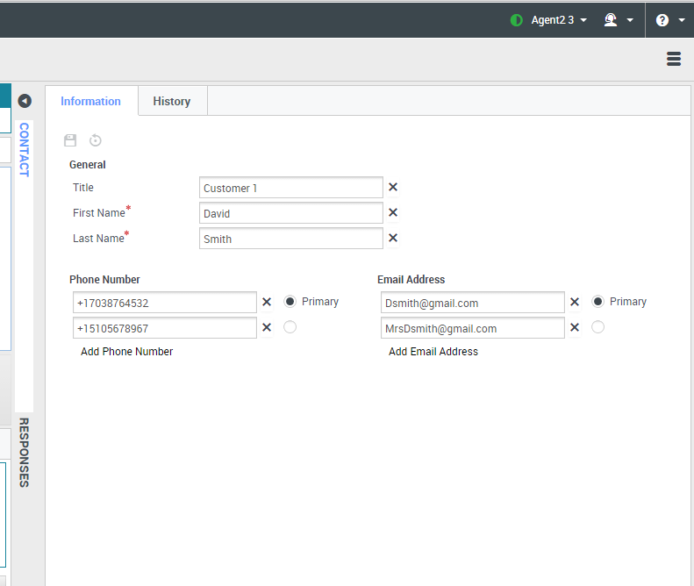
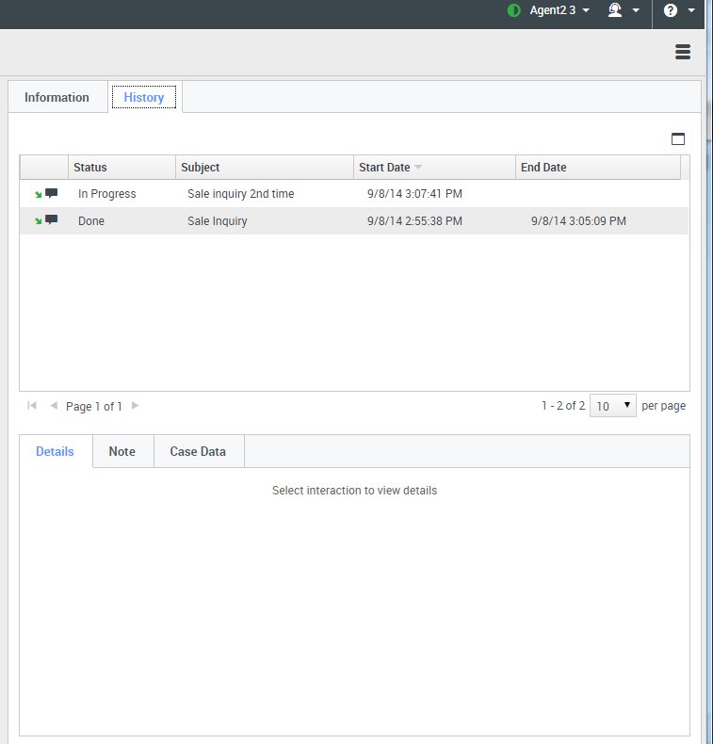
Contact History View
The History tab displays the contact history, which details the interactions that agents selected in the Contact History view of the person contacting the contact center.
Notes:
The History tab displays the contact history view information detailing interactions that agents have selected in the Contact History view.

Slide 13
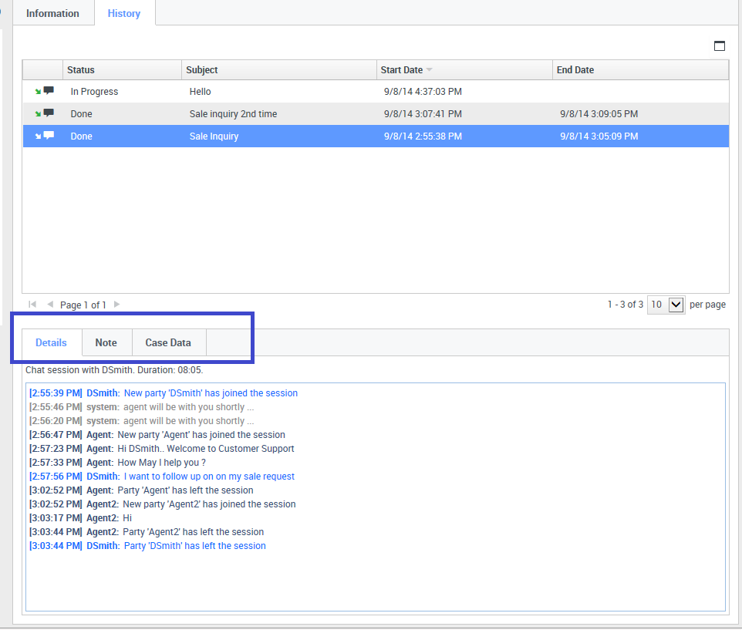
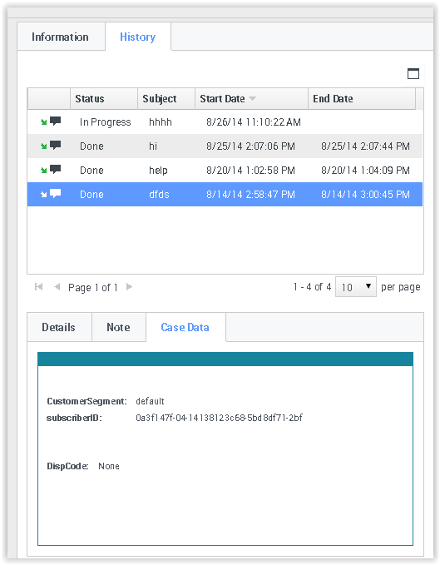
Contact History Notes, Details, and Case Data
Agents can use Details to view information such as time stamp, chat transcript, and chat subject
Agents can use Note to attach a note to the interaction history
Agents can use Case Data to view the case information for the interaction history
Notes:
Agents can use Details to view information such as time stamp, chat transcript, and chat subject.
Agents can use Note to attach a note to the interaction history.
Agents can use Case Data to view the case information for the interaction history.

Slide 14
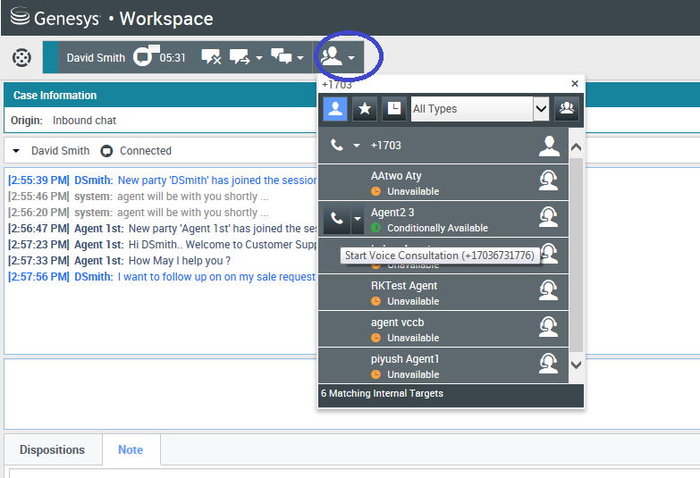
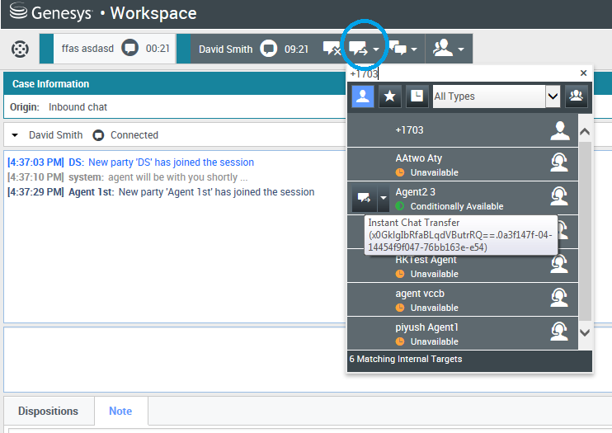
Chat Control –
Voice Consultation and Chat Transfers
Agents can start a voice consultation with another agent about their chat session
Agents can transfer their active chat interaction to their consultation target
Notes:
Agents can start a voice consultation with another agent about their chat session.
Agents can transfer their active chat interaction to their consultation target.

Slide 15
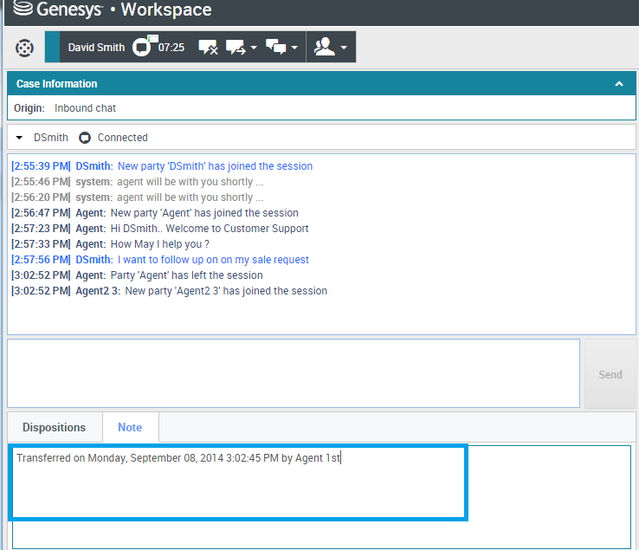
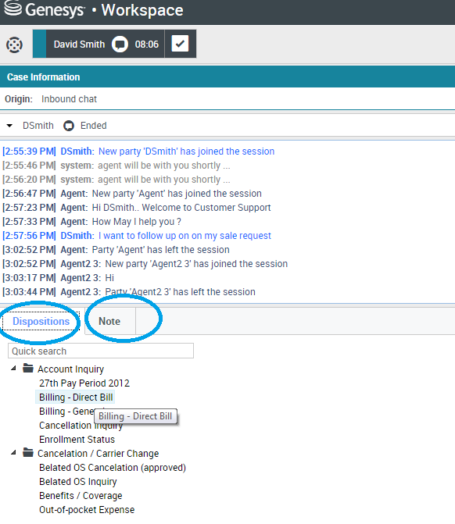
Chat Transfer History, Note, and Dispositions
Agents can:
view the Chat Transfer history in Note
use Note to enter comments about the current chat interaction or read older comments
use Dispositions to assign a code to an ongoing or completed interaction
Notes:
Agents can:
view the Chat Transfer history in Note
use Note to enter comments about the current chat interaction or read older comments
use Dispositions to assign a code to an ongoing or completed interaction

Slide 16
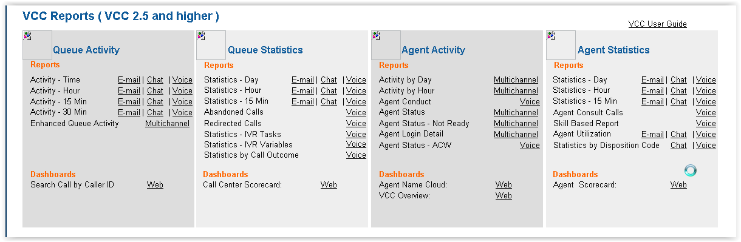
CX Analytics Chat Features Overview
New Channel (Chat, Email, and Multichannel) reports for increased reporting capabilities.
Multichannel reports include statistics for all channels to which the agent is assigned.
New Channel Reports - Chat, Email, and Multichannel
Notes:
New Channel (Chat, Email, and Multichannel) reports for increased reporting capabilities.
Multichannel reports include statistics for all channels to which the agent is assigned.

Slide 17
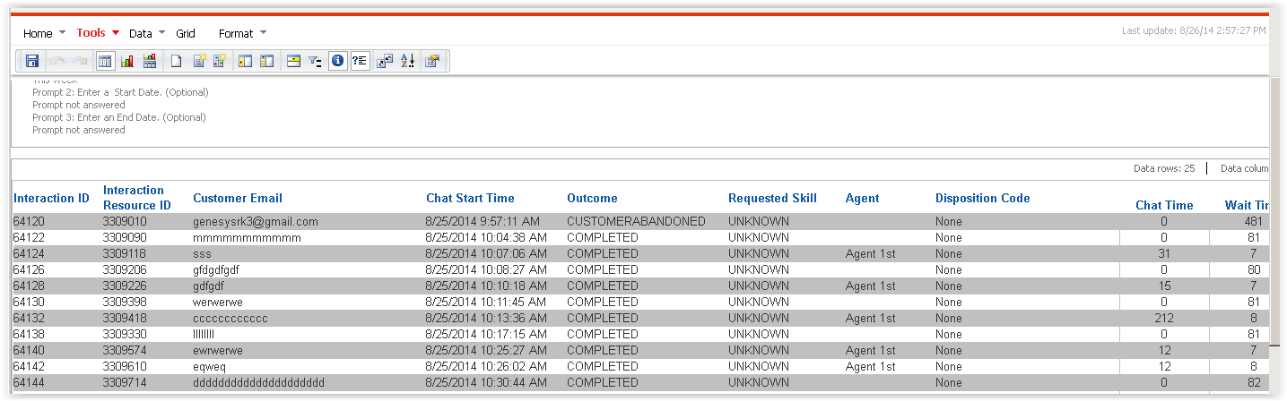
Queue Activity - Time: Chat Report
Notes:
Queue Activity - Time: Chat report

Slide 18
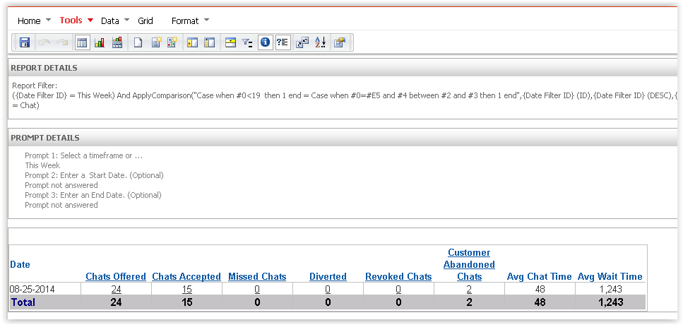
Queue Statistics - Day: Chat Report
Notes:
Queue Statistics - Day: Chat report

Slide 19
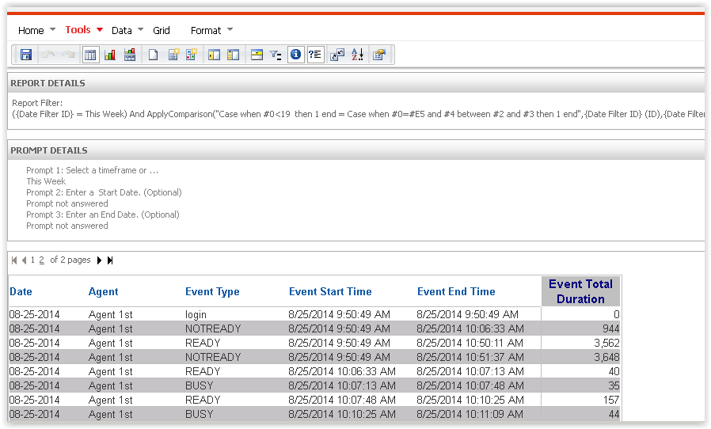
Agent Activity – Day Report
Notes:
Agent Activity – Day report

Slide 20
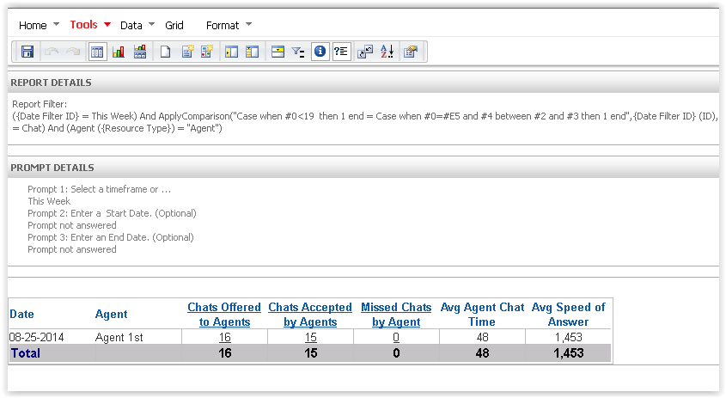
Agent Statistics - Day: Chat Report
Notes:
Agent Statistics - Day: Chat report

Slide 21
Customer Website Chat Widget
A Chat widget is provided to install on the client’s website.
Each chat widget must have a skill assigned for routing and can be modified by the client for a specific look and feel.
The client can see when an agent is typing and can initiate and end a chat interaction.
The client is notified of agent availability with the following messages:
    an agent will be with you shortly
    an agent is available and connecting
    an agent is connected
Notes:
Chat widgets are provided to install on the customer’s website.

Slide 22
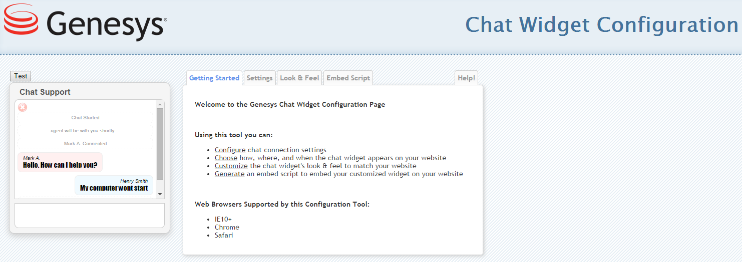
Premier Edition: VCC Chat Widget
Allows clients to customize their own Chat widget by copying the embedded API script.
Notes:
Clients can customize their own Chat widget by copying the embedded API script.

Slide 23
Thank You!

