Slide 1



Alfresco Phase One Roll-Out
Test changing again
10/31/2012

Slide 2
Agenda
  Sites and Dashlets Overview
  Genesys Alfresco Instance
  Upload/Manage Content
  Aspects
  Working with the Calendar
  Roles/Permissions
  Workflow
  Working with FTP
  Search Syntax
  Additional Alfresco Concepts
    Publishing
    Categories vs Tags
  Known Issues
  For questions and bugs email: alfrescosupport@genesyslab.com
  Q&A

Slide 3
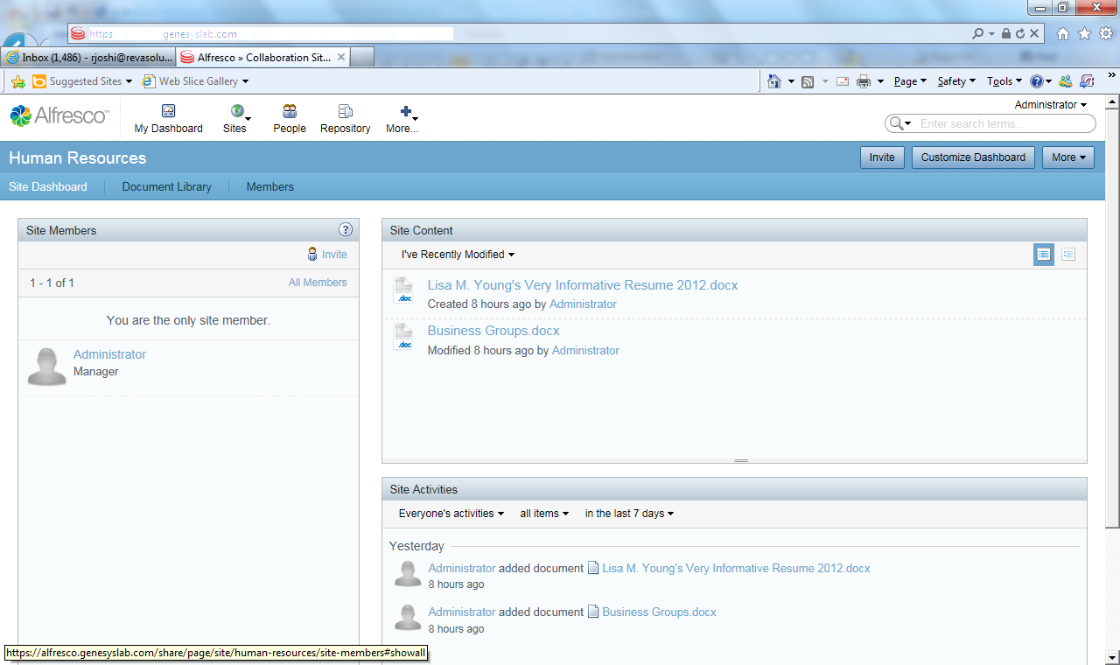
Sites and Dashlets Overview
  Sites:
    Community space for a particular subject matter including content storage
    Site dashboard provides overview of site activity
    Sites can provide collaboration capabilities such as:
      Calendars
      Wiki Pages
      Discussions
      Blogs
      Links
      Data Lists
    You must accept your invitation from the site manager to participate in site level activities

Slide 4
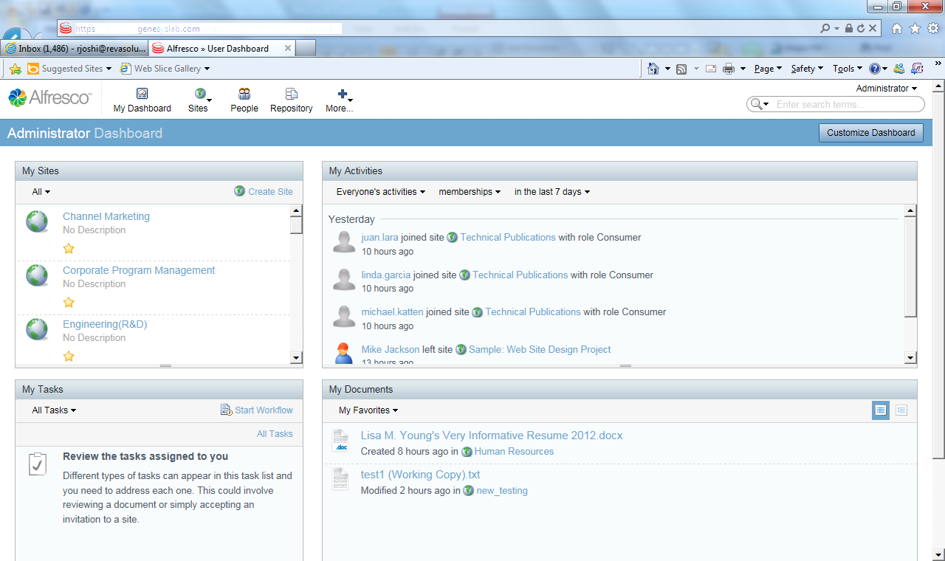
Sites and Dashlets Overview Cont’d
  Dashlets:
    Site dashboards are made up of dashlets
    Dashlets provide roll-ups of information happening within a particular site
    Dashlets also make up your own personal dashboard
    Place personal dashlets on your dashboard
      Sites
      Tasks
      Activities
      Profile
      RSS Feed
      And many others
    Managers can configure what dashlets/features are available/site

Slide 5
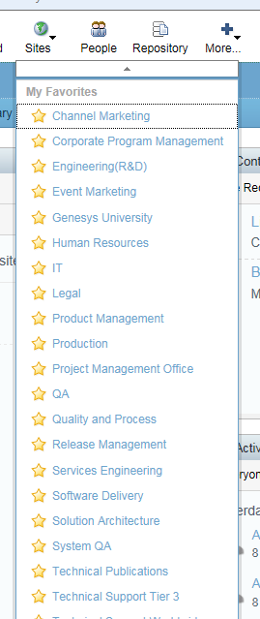
Genesys Alfresco Instance
  Integrated with corporate active directory for single sign-on
  Open access sites have been built out for each major business unit
  Content in these sites is currently visible. Request to become a site member to have full access to site activities
  Site managers can add additional sites for team use. These sites can be restricted
  Via Alfresco, we will provide areas to publish content for external consumers: partners, clients, vendors, contractors, etc.
  Certain tags have been reserved for corporate use
  Aspects have been developed to support specific needs of particular business units
  A general Genesys aspect is available for all corporate documents
  Always looking for feedback!

Slide 6
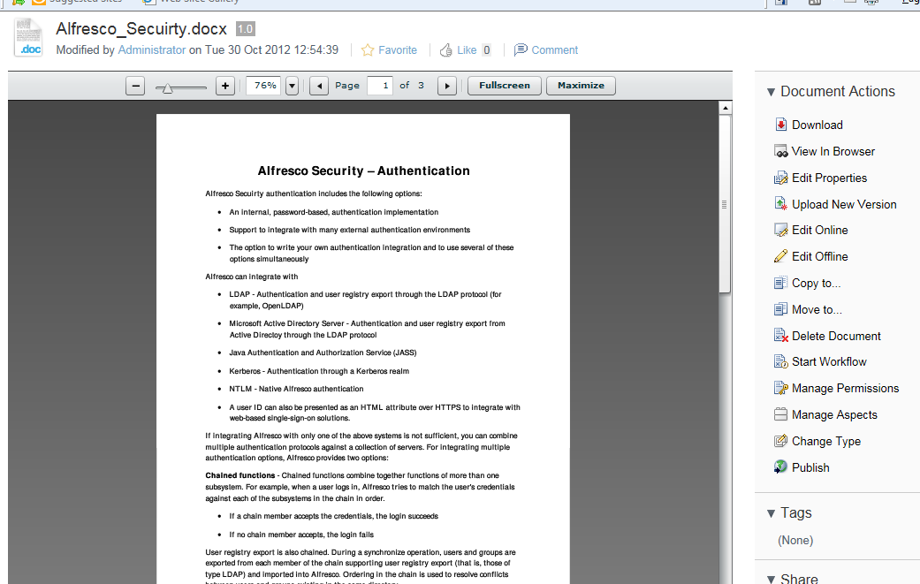
Upload/Manage Content
    Upload content via ‘Upload’ prompt or drag and drop onto document library
    Also create content inline
    Click on document link to manage the document and associated properties
    Preview/edit the document directly in your browser
    Editing Offline locks the document for editing by other people – read only
    Manage versions, aspects properties, tags, permissions, document types, workflows if desired, comments, etc.

Slide 7
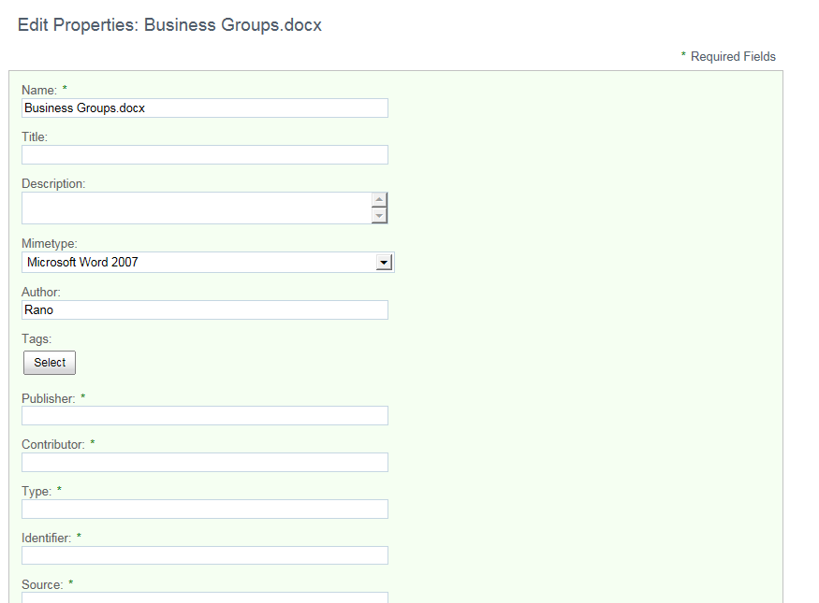
Aspects
    Aspects are used to provide context to a document through associating a value with a particular property
    Using aspects greatly improves discoverability in search
    Click ‘Manage Aspects’ to apply aspects to your document. You can apply more than one.
    For Roll-Out, we will start with the following departmental aspects:
      Corporate Operations
      Event Marketing
      Quality and Processes
      Project Management Office
      Standard Genesys Aspect
    Values immediately show up in property panel

Slide 8
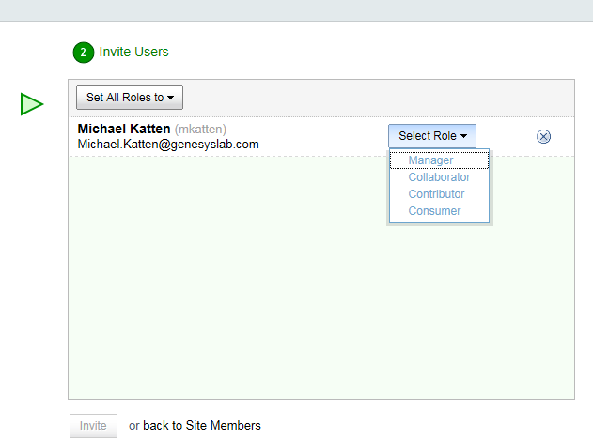
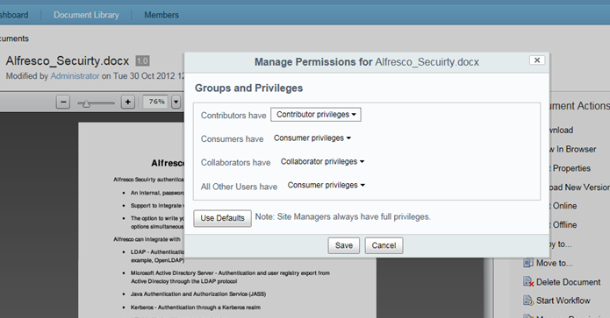
Roles and Permissions
    Use roles and permissions to control who has access to sites and documents
    Alfresco comes with five standard roles out of box:
      Site Managers : full rights to all site content — what they have created themselves and what other site members have created.
      Collaborators: full rights to all site content they own; they have rights to edit but not delete content created by other site members.
      Contributors: full rights to all site content they own; they cannot edit or delete content created by other site members.
      Consumers: have view-only rights in a site: they cannot create their own content
      Administrators: full privileges to entire repository
    We may be adding additional roles going forward
    Site Managers and Admins can invite users to sites
    You can view individuals’ site roles in the members list

Slide 9
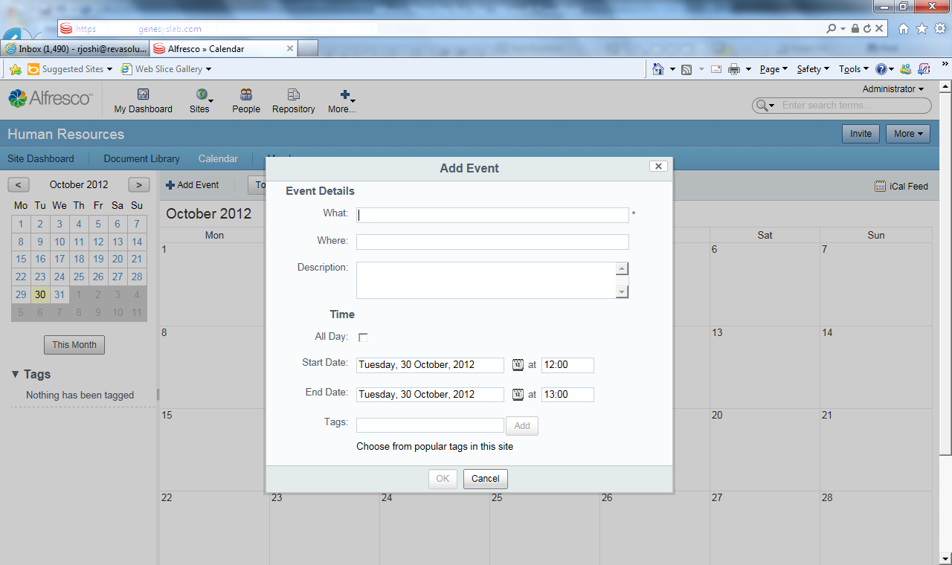
Working with the Calendar
    The calendar is one of the features available for sites
    Calendar event properties are standard and do not include ‘Organizer’
    For this release, ‘Organizer’ can be indicated in the description field.
    We will look at customizing the calendar fields in Phase Two
    We will also explore synchronization with the Outlook calendar via the iCal feed

Slide 10
Demo

Slide 11
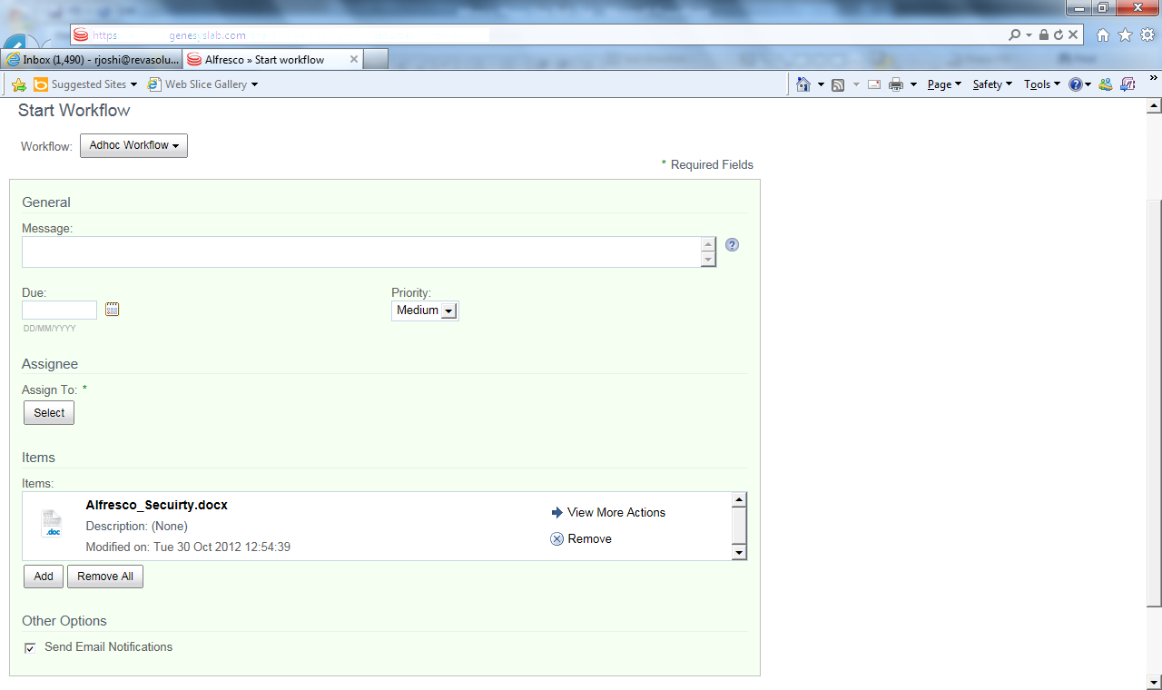
Workflow
    Alfresco comes with 5 approval workflows out-of-box which can be added to individual documents
    These may not be sufficient for Genesys in general. We will look into potential custom workflows going forward.
    Feel free to try out-of-box workflows as they do provide automation of approval cycles with notifications
    Please provide feedback!

Slide 12
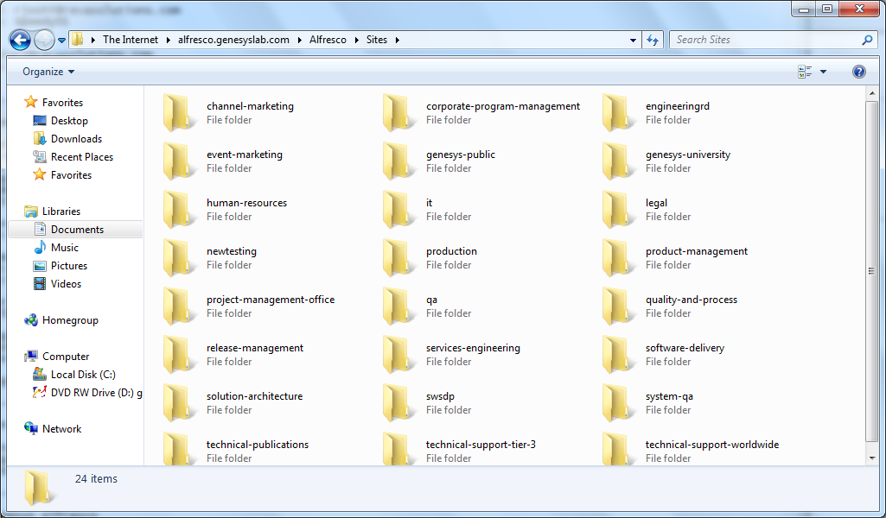
Working with FTP
  ftp://alfresco.genesyslab.com/
  Use FTP for large files (2 BG and over) and folder mapping

Slide 13
Search Syntax
  The list below provides some tips and tricks for using the Alfresco Search feature:
    Search for a single term – terms cannot contain whitespace:
        Example: banana, or TEXT: pumpkin
    Search for a phrase – enclose in double quotes:
        Example: “big orange pumpkin”
    Search for an exact term – prefix with ‘=‘:
        Example: =cooking
    Term Expansion/Tokenization – prefix with ‘~’:
        Example: ~cooking
    Conjunctions – combine terms or phrases using ‘AND’:
        Example: big AND orange AND pumpkin
    Disjunctions – combine terms or phrases using ‘OR’:
        Example: big OR orange OR pumpkin
    Negation – exclude terms or phrases using ‘NOT’:
        Example: big NOT orange
    Fields – search specific fields. If not indicated, TEXT is used by default:
        Example: DOCUMENTTYPE:whitepaper
    Wildcards – use ‘*’. Can be used in combinations with other operators:
        Example: pump*
  And there’s more… email for details!
    banana or TEXT: banana
    Community space for a particular subject matter
    Site dashboard provides overview of site activity

Slide 14
Additional Alfresco Concepts
  Categories vs Tags:
    Use tags for adding additional context to your documents
    Genesys corporate has a list of reserved tags
    Tags are lower case only
    Add tags which are relevant to you (including new tags)
    Categories are an older Alfresco concept and we will not be using them within Genesys
  Publishing:
    Publishing allows you to publish content to various social media websites
    We are currently not implementing any publishing channels
    Use the external facing website for publishing external content

Slide 15
Things To Note
  Drag and Drop does not work with Internet Explorer
  Use FTP for uploading/downloading files over 2 GB
  We will be opening up sites for publishing external content anonymously, to customers, to partners, to vendors, etc.
  We will be working on custom workflows specifically for Genesys in Phase 2. Feel free to use existing workflows and provide feedback
  Integration with MediaWiki and Jive (Café G) are also part of next phase
  Log in using your Genesys alias and password
  Don’t forget to accept invitations to sites to participate
  For reference:
    How To Tutorials
    http://www.alfresco.com/resources/documentation
    http://wiki.alfresco.com/wiki/Main_Page

Slide 16
Next Steps
  Start working with Alfresco!
  Currently reviewing feature requests for Phase Two, Phase Next
  Includes items discussed in working sessions
  Phase Two begins immediately
  For questions or bugs, email alfrescosupport@genesyslab.com

Slide 17
Q & A

